Slide 1
Part 1:
Decision Making by Consumers

Slide 2
An Economics Perspective on Decisions
As individuals, any time we make a decision, unconsciously in our minds, we make some type of a trade-off:
- Should I take the bus or ride a bike?
- Should I go to bed early or watch one more episode of my favourite show?
- Should I go back to school or not?
We typically make decisions about:
How to allocate our resources given their limitedness
How to allocate our time given its limitedness
Notes:
The study of economics can be divided into two streams: macroeconomics and microeconomics. Macroeconomics is the study of the economy as a system in which interactions and feedbacks among sectors determine national output, employment, and prices. Microeconomics, on the other hand, is the study of individual behaviour in the context of limited resources.
Decisions are always subject to some limit
These decisions concern not only us as consumers. We face similar constraints (just on a different scale) when we are business owners, government officials, charity managers, etc.

Slide 3
Trade-offs and Constraints (1)
When we make a decision/choice, we need to recognize what is being sacrificed to make this choice.
Limits or constraints are ultimately reflected in making choices.
In economics we say that when we make a choice, we need to recognize the opportunity cost of this choice.
The opportunity cost of a choice is what must be sacrificed when a choice is made. That cost may be financial, it may be measured in time, or simply the alternative foregone.

Slide 4

Trade-offs and Constraints (2)
When we make choices subject to constraints, it means we make decisions in the presence of scarcity
Options:
  Sleep, work, study, food, shelter, transportation, entertainment, etc.
Limitations:
  Time and income
  We cannot do all things all the time
  Many choices are routine and driven by necessity
    You have to eat, sleep and you need a place to live
    If you are a student - you need to study, if you have a job - you need to work

Slide 5
The Case of Distorted Decision-Making
In making decisions, it is important to account not only for what is seen, but also what is unseen.
For example, you are deciding to go to the movies:
What is seen in this decisions?
  Expenses you will incur for buying a movie ticket/popcorn, etc
  The time you commit to this choice of leisure
  Anything else?
What is unseen in this decision?
  The risk of getting into a car accident when driving to/from movies
  The risk of catching a virus at a movie theatre
  Anything else?

Slide 6

More on Decisions
Consider a simple example:
  You love chocolate and your favourite chocolate candy is Lindt’s chocolate truffles
  You devour the first three truffles
  Would you like a 4th truffle? Maybe yes
  The question is how will you feel after eating the 4th one. Will you feel just like you felt after the first one or different?

Slide 7
More on Decisions
Should I eat another truffle, should I drink another glass of wine, should I watch another episode?
What is in common about these decisions?
  These are all decisions on the margin

Slide 8
Total Utility
Each time you eat a truffle your satisfaction increases. At first, your satisfaction rises steadily because you are hungry for the truffles. As you eat more, your total utility continues to rise, but at a slower pace. It plateaus when you reach full satisfaction – you are no longer hungry for the truffles.

Slide 9
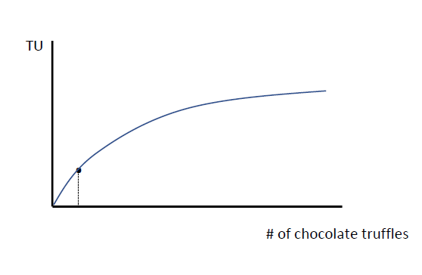
Total Utility of Chocolate Truffles
Notes:
What does this graph represent?
This graph depicts total satisfaction (utility) an individual would obtain from chocolate truffles.
Utility is an economics term for satisfaction. Every time you eat at truffle, your satisfaction rises. As your satisfaction grows, total utility continues to rise, but at a slower pace.
It plateaus as you are no longer hungry for the truffles.

Slide 10
Marginal Utility
What is marginal utility?
  Marginal utility is the satisfaction an individual obtains from one more unit of good or service that an individual consumes.
  If I eat one more truffle, what does this mean for my satisfaction from only this one truffle?

Slide 11
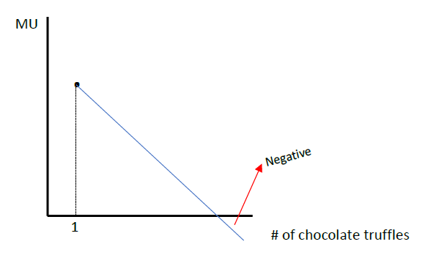
Marginal Utility of Chocolate Truffles
Notes:
What does this graph represent?
The very first chocolate truffle will be super delicious for someone who loves chocolate. Its marginal utility is high because this is the first unit this individual consumes.
As a person consume each consecutive truffle, its satisfaction from each additional unit is declining. Don’t get it mixed with total satisfaction, which is rising. On the margin, each additional unit is less appealing than the previous.
How can a person experience NEGATIVE marginal utility?

Slide 12
Diminishing Marginal Utility
Diminishing marginal utility implies that the addition to total utility from each extra unit of a good or service consumed is declining.
The concept of diminishing marginal utility is essential when implementing government policies. Why do you think that is?

Slide 13
Textbook Example: Jazz and Skiing
The example of chocolate truffles focuses only on one good.
Review the textbook example where Neal derives utility from jazz and skiing for additional context (pgs. 126-130)

Slide 14

Learning Outcomes
Opportunity cost
Scarcity
Decisions at the margin: diminishing marginal utility

