Slide 1

Part 2: Consumer’s Demand

Slide 2
Quick Recap
In part 1, we covered the following concepts:
Opportunity cost
Scarcity
Total utility and marginal utility
Diminishing marginal utility
In Part 2, we will build on the concept of utility to derive consumer’s demand

Slide 3
From Utility to Demand
Utility theory is a useful way of analyzing how consumers make choices.
But in the real world we do not observe consumer’s utility, either total or marginal.
Instead, his or her behaviour in the marketplace is observed through the demand curve.
How are utility and demand related?

Slide 4
Roadmap: From Utility to Demand
To answer the question “How are utility and demand related?”, we will follow this roadmap:
Tastes, preferences and utility – what’s the connection?
Our preferences maybe unlimited, but our budget is not
Marginal utility vs. marginal utility per dollar

Slide 5
Tastes, Preferences and Utility – What’s the Connection?
Let’s use a textbook example of Neal choosing to attend jazz bars and go snowboarding
Individual’s utility is a measure of satisfaction an individual derives from goods and services
Individual’s choice of goods and services form a consumption bundle
Neal will have several combinations of snowboarding and jazz that would yield him the same level of satisfaction (utility)
  In other words, Neal will be indifferent between some combinations of snowboarding and jazz as long as they yield the same level of utility

Slide 6
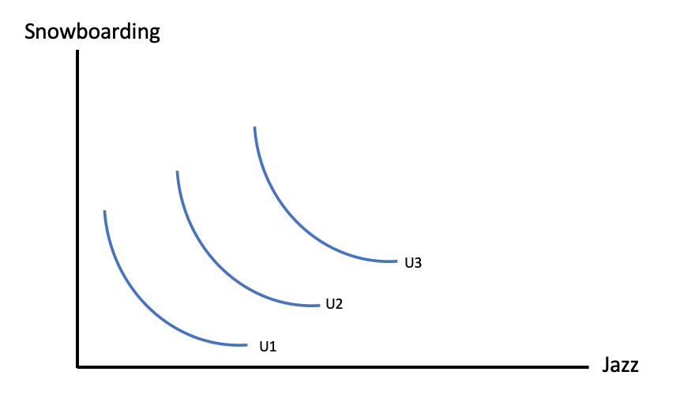
Our Tastes and Preferences are Unlimited
Neal’s preferences for snowboarding and jazz will be represented by the indifference curves. The higher is the indifference curve, the higher is Neal’s satisfaction from a chosen consumption bundles.
Notes:
This graph is adopted from Figure 6.8: Indifference Curves (pg.138) in the Principles of Microeconomics 2017 Edition
An indifference curve defines combinations of goods and services that yield the same level of satisfaction to the consumer.
The slope of the indifference curve is the marginal rate of substitution (MRS) and defines the number of units of the good on the vertical axis that the individual will trade for one unit of the good on the horizontal axis.
The MRS decreases as we move right because the consumer values the good more highly when he has less of it.
An indifference map is a set of indifference curves, where curves further from the origin denote a higher level of satisfaction. There are four properties of this map that help us understand why the indifference curves have their smooth convex shape:
Indifference curves further from the origin reflect higher levels of satisfaction.
Indifference curves are negatively sloped. This reflects the fact that if a consumer gets more of one good she should have less of the other in order to remain indifferent between the two combinations.
Indifference curves cannot intersect. If two curves were to intersect at a given point, then we would have two different levels of satisfaction being associated with the same commodity bundle—an impossibility.
Indifference curves are convex when viewed from the origin, reflecting a diminishing marginal rate of substitution.

Slide 7
Our Tastes and Preferences are Unlimited
When Neal snowboards less, he is willing to give up less snowboarding than when he has a lot of it, in order to get the same additional amount of jazz.
His willingness to substitute diminishes as he moves to the right along the indifference curve.

Slide 8
Tastes, Preferences and Utility – What’s the Connection?
Our satisfaction (utility) is composed of tastes and preferences for goods and services.
These tastes are captured by the indifference curves.
The higher is the placement of the curve, the greater is our satisfaction from a chosen bundle of goods and services.

Slide 9
The Budget Constraint
Consumer’s budget constraint defines consumption possibilities given consumer’s income and prices of goods and services.
Neal has a monthly expenditure limit, or a budget constraint, which he chooses to spend on lift tickets and jazz club visits.
Is it possible to consume beyond your budget constraint? If so, for how long?

Slide 10
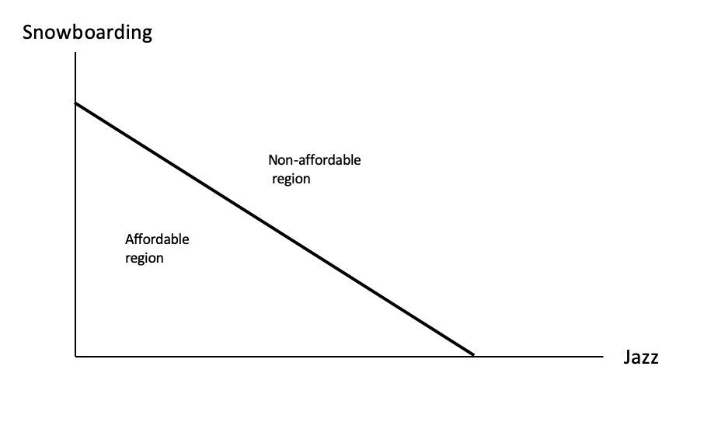
The Budget Constraint
Notes:
This graph is adopted from Figure 6.6: Budget Line (pg.135) in the Principles of Microeconomics 2017 Edition
The budget constraint line shows where the amount of each good is consumed on the axes.
The x intercept represents Neal spending his full budget on jazz
The y intercept represents Neal spending his full budget on snowboarding
In addition to the affordable extremes. Neal can also afford many other bundles. The set of feasible, or affordable, combinations is bounded by the budget line.
The slope of the budget line is informative:
It indicates how many snowboard visits must be sacrificed for one additional jazz visit.
It defines consumer trade offs.
Any point along the line is an affordable bundle that fully exhausts his budget. Points under the curve are also affordable, however, any point under the line would indicate that Neal is not spending his full budget.
In contrast, points above the line are unachievable, as Neal would not be able to afford that bundle of goods and services given his budget constraint.
The affordable set of goods and services for the consumer is bounded by the budget line from above; the non-affordable set lies strictly above the budget line.

Slide 11
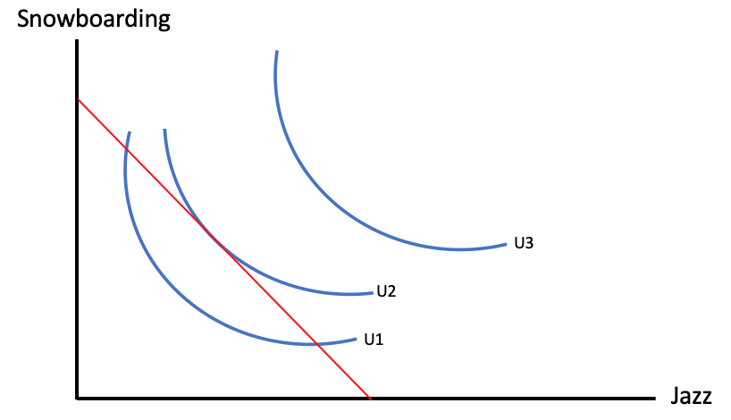
Achieving Highest Level of Utility
We are now in a position to examine how the consumer gets to the highest level of satisfaction possible.
This is called optimization – maximizing utility subject to the budget constraint.
Notes:
This graph is adopted from Figure 6.9: The Consumer optimum (pg.140) in the Principles of Microeconomics 2017 Edition
We can see several of Neal’s indifference curves in conjunction with his budget constraint.
He maximizes his utility, or satisfaction, at the point where the budget line is tangent to the indifference curve denoted by U2.
The points where U1 intersect with the budget line are also on the boundary of the affordable set, however the do not yield as much satisfaction as the tangent point, because it lies on a higher indifference curve.
The highest possible level of satisfaction is attained, therefore, when the budget line touches an indifference curve at just a single point – where the constraint is tangent to the indifference curve.

Slide 12
Achieving Highest Level of Utility
The highest possible level of satisfaction is attained, therefore, when the budget line touches an indifference curve at just a single point – where the constraint is tangent to the indifference curve.
Why is it that the consumer cannot choose a consumption bundle within the budget constraint?

Slide 13
Spending the Marginal Dollar
When deciding to purchase a good, a consumer weighs the additional utility to be derived from the good against the additional cost (price) of the good.
Consumer needs to consider two factors – his marginal utility in relation to the price
This means the consumer will base his decision on the marginal utility per dollar
  If the price of a good rises, the marginal utility per dollar of that good falls and gives the consumer an incentive to consumer fewer units of the good.

Slide 14
From Utility to Demand
Previous slide confirms the Law of Demand:
  If the price of the good rises, individual will consume less of that good, that is the quantity demanded of that good falls.
  This is because with a higher price, individual gets less utility of that good at the margin, or his marginal utility per dollar falls.
Notes:
Referring back to the Neal example, we make a few assumptions:
His spending is allocated between only two activities: visits to Whistler and the jazz club.
He will exactly exhaust his entire budget on these two activities.
We can think of his combination of spending as one point on the demand curve, where the “other things kept constant” are the price of jazz, price of snowboarding pass, his income, and his tastes.
Suppose the price of a lift ticket increases:
The marginal utility per dollar associated with each visit to Whistler changes. As a result, a new allocation of his budget between the two goods will be determined in order to maximize his utility.
In this case, Neal will reduce his visits to Whistler and allocate more of his budget to jazz club visits, reflecting a new point on the demand curve.
Suppose the price of a lift ticket decreases:
Again, Neal will reallocate his budget to maximize utility. This time, he will increase his visits to the mountain and reduce his visits to the jazz club, establishing a new point on the demand curve.

Slide 15
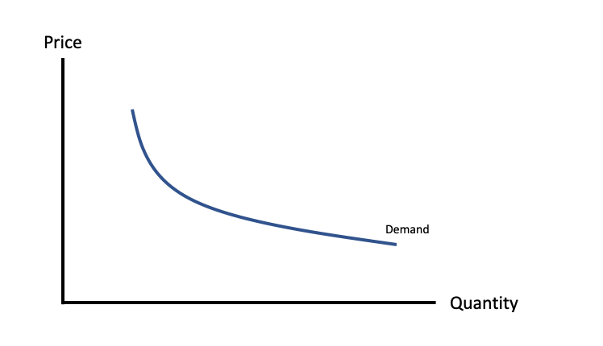
Demand Curve
Demand curve is downward sloping because as price falls, quantity demanded rises.
Notes:
This graph is adopted from Figure 6.5: Utility to demand (pg.133) in the Principles of Microeconomics 2017 Edition

Slide 16
Factors Affecting Demand
Quantity Demanded vs. Demand – when do use which term?
Quantity demanded changes only with the change in price. As price increases (decreases), quantity demanded falls (rises).
Demand changes in response to changes in:
  Prices of related goods
  Tastes
  Income
  Population
  Expectations
Review a word document on UR courses – factors that affect demand

Slide 17

Learning Outcomes
Utility theory: tastes, preferences and indifference curves
Budget constraints
Optimization
Consumer’s demand: law of demand, factors affecting demand

