Slide 1
Decision-making by Producers

Slide 2

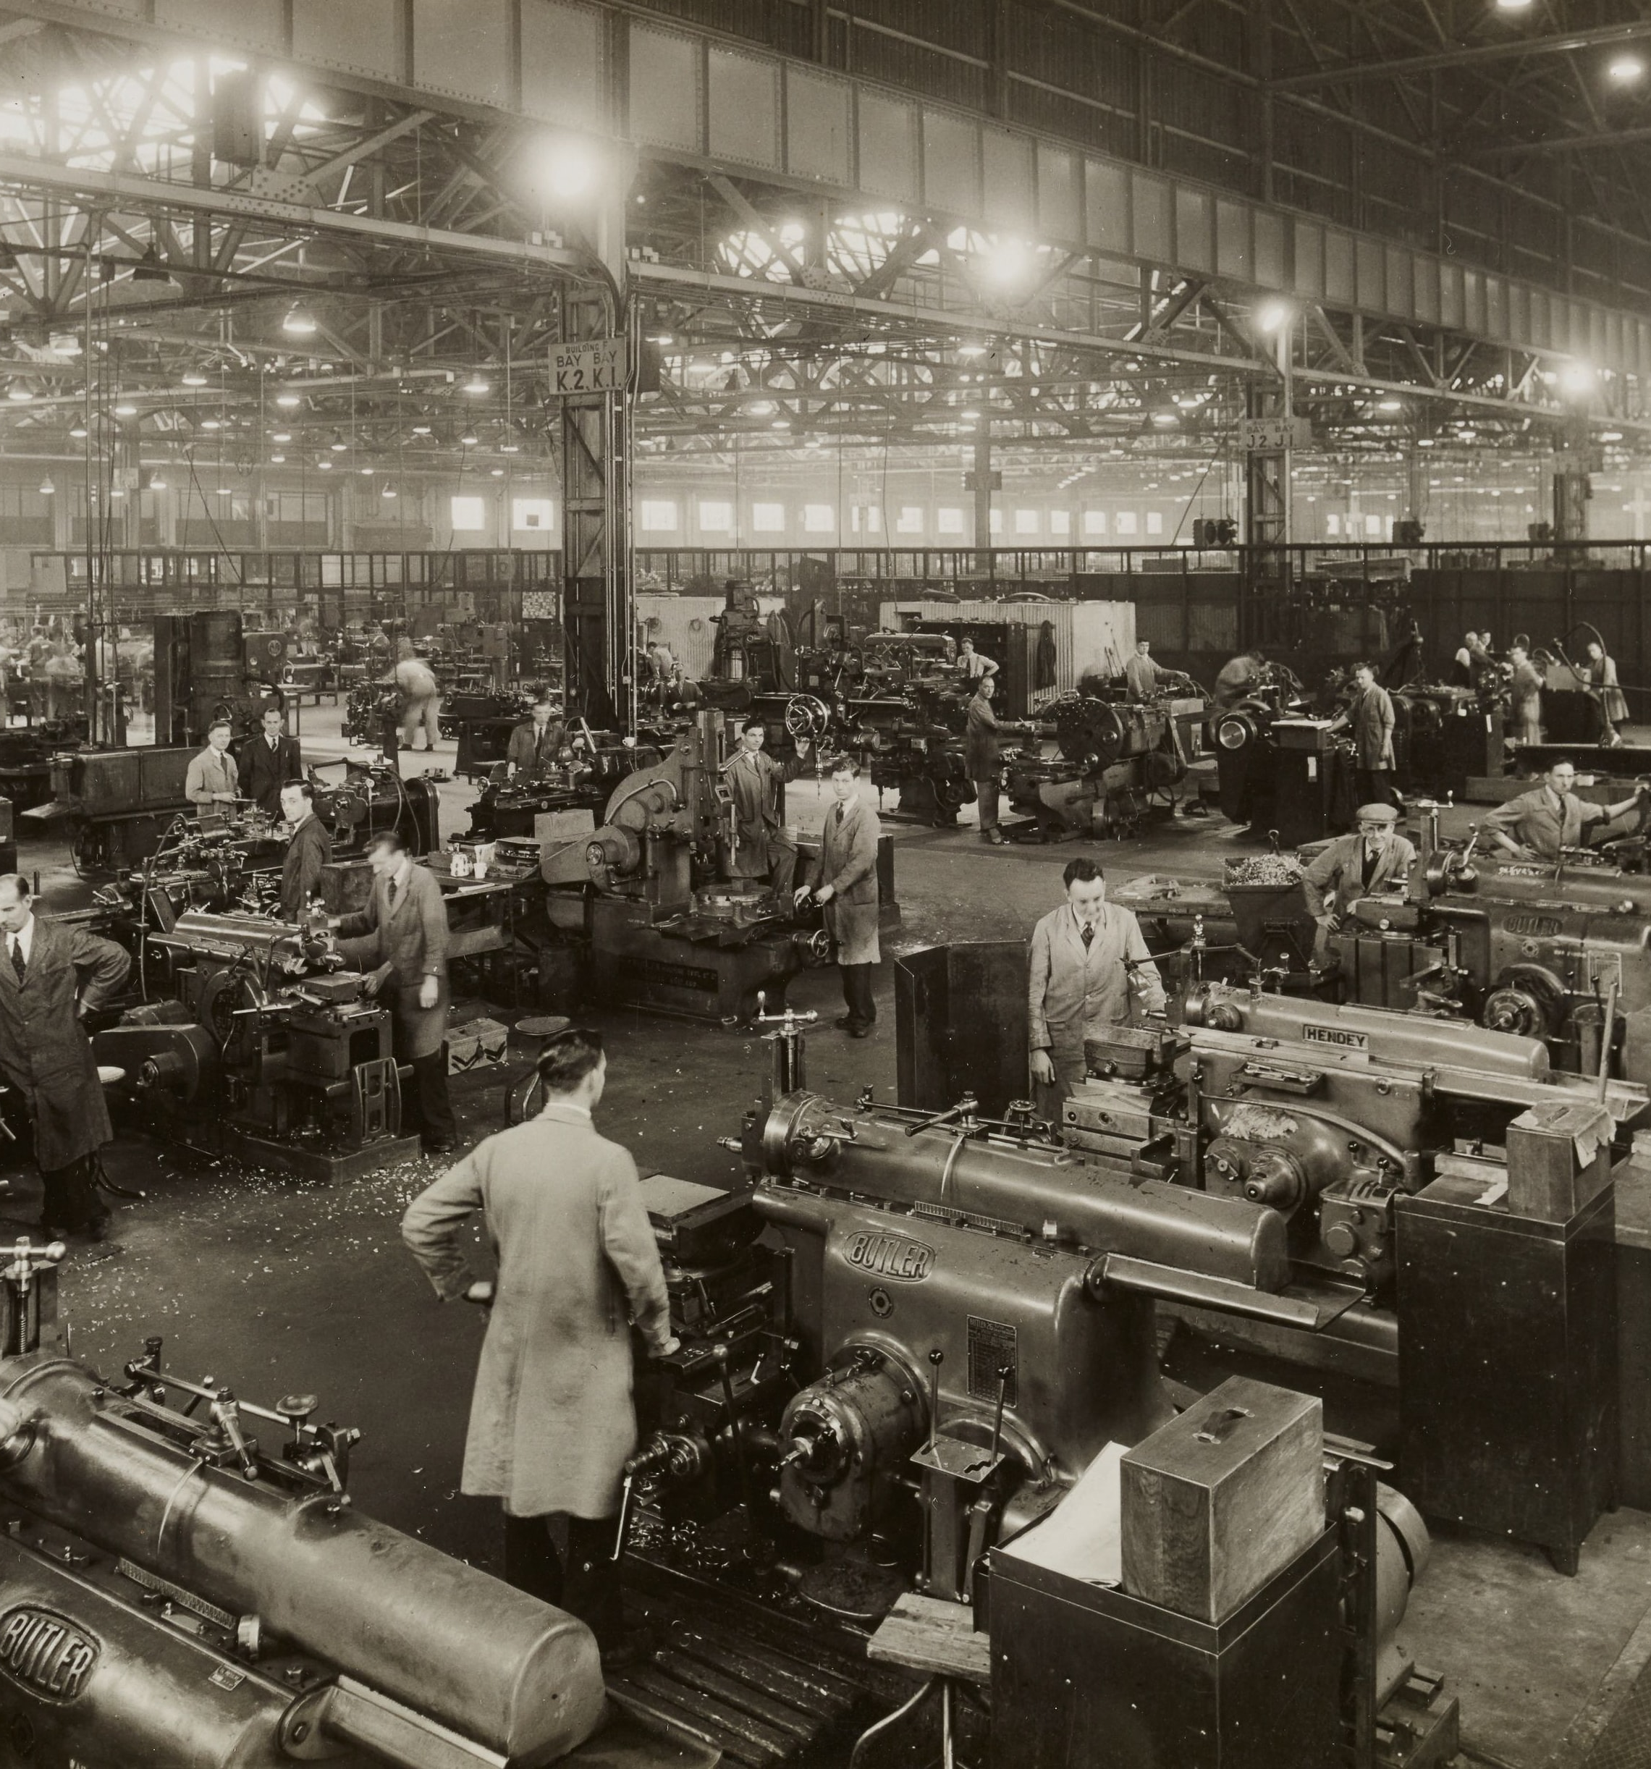
What is this lesson about?
The focus of this lesson is on conceptualizing producer choice
  What decisions do producers and sellers make?
By identifying producer decisions, we will be able to derive the supply side of the market

Slide 3

Example: Production of Snowboards
Black Diamond Snowboards (BDS) is a start-up snowboard producing firm. Its founder, Tom, has invented a new lamination process that gives extra strength to his boards. He has set up a production line in his garage that has four workstations: laminating, attaching the steel edge, waxing, and packing.
He is the only one doing all the jobs – from production, to book-keeping, to marketing, to selling.
What is Tom’s productivity now and how will it change if he hires a worker?
He would benefit from hiring an extra worker because together they can produce more. In other words, the output per worker will increase.

Slide 4
Example: Production of Snowboards
By increasing the number of workers, BDS will produce more boards.
The relationship between output and labour (workers) is represented by the total product (TP)
Output increases with the amount of labour used. Initially the increase in output due to using more labour is high. This initial phase characterizes increasing productivity.
As more workers are hired, total productivity will change. How will it change?

Slide 5
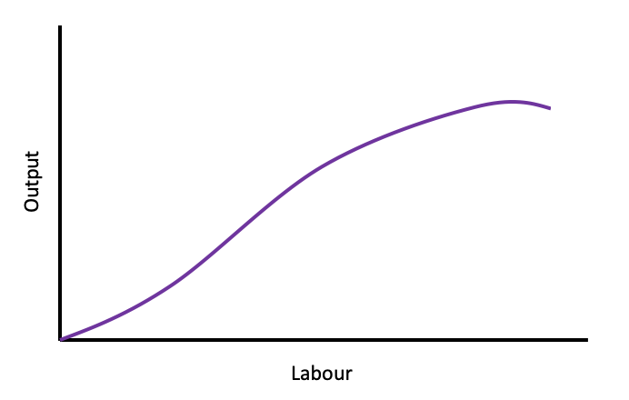
Figure 1: Total Product Curve
Notes:
This graph is adopted from Figure 8.1: Total Product Curve(pg.171) in the Principles of Microeconomics 2017 Edition

Slide 6
Total Production
Explanation of Figure 1:
The relationship between total output and workers is positive, indicating that more workers produce more boards. Total product curve has an interesting pattern.
With the expansion of employment, total product curve becomes progressively steeper
After this phase it is completed, total product curve is flatter
These different stages in the TP curve tell us a great deal about productivity in BDS.
As the number of workers increase, total output is rising but its increases are slower after employing a certain number of workers. In other words, each additional workers contributes less to the increase in total ouput.

Slide 7
Marginal Production
Additional output that is produced by an additional worker is called marginal product (MP) or marginal product of labour
Marginal product defines incremental, or marginal, contribution of the worker.

Slide 8
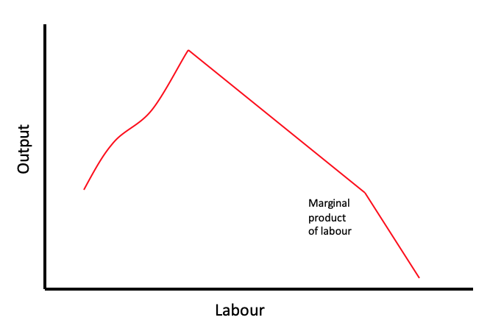
Figure 2: Marginal Product Curve
Marginal product of labour is the addition to output produced by each additional worker.
Notes:
This graph is adopted from Figure 8.2: Average and marginal product curves (pg.172) in the Principles of Microeconomics 2017 Edition

Slide 9
Marginal Production
Explanation of Figure 2:
The marginal product curve initially rises and then declines, reflecting increasing and decreasing productivity.
During the initial stage of production expansion, the MP of each worker is increasing as new workers are hired. Each worker is able to spend more time at his workstation, and less time moving between tasks.
At a certain point in the employment expansion, the MP reaches a maximum and begins to tail off. At this stage, additional workers continue to produce additional output, but at a diminishing rate.
The declining MP is due to a constraint of a fixed number of capital – all workers must share the same tools.

Slide 10
Diminishing Marginal Returns
The phenomenon where in the face of a fixed amount of capital, the contribution of additional units of a variable factor must eventually decline is known as the law of diminishing returns.
Law of diminishing returns: when increments of a variable factor (labour) are added to a fixed amount of another factor (capital), the marginal product of the variable factor must eventually decline.
Example: Production of Snowboards
  If too many workers are hired, the garage, where snowboards are produced, will become too crowded and they will obstruct the operation of the production process. Thus, they will never be employed by the producer.

Slide 11
How does productivity translate into costs?
While the owner of BDS may understand his productivity relations, his ultimate goals is to make profit, and for this he must figure out how productivity translates into cost.
The first step is to relate inputs to costs:
  Incurred costs for fixed inputs (garage, tools, etc.) will translate into fixed costs
  Incurred costs for variable inputs (workers, etc.) will translate into variable costs
  Total costs are the sum of variable costs and fixed costs
We use the terms fixed, variable, and total costs to define the cost structure of a firm.
These costs are depicted in Figure 3 (next slide)

Slide 12
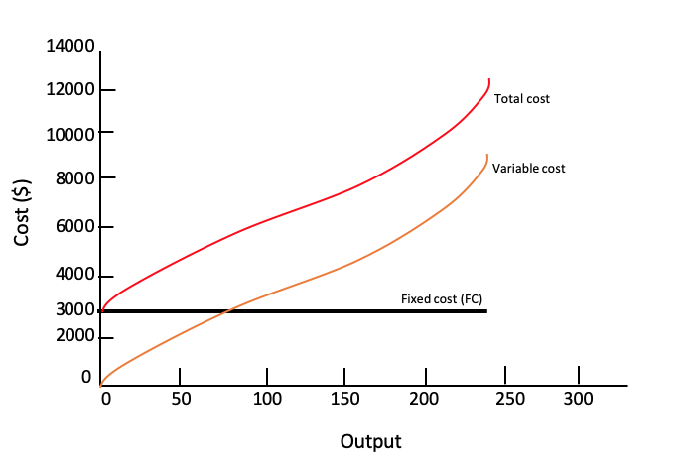
Figure 3: Cost Structure (Total, Variable and Fixed)
Notes:
This graph is adopted from Figure 8.3: Total cost curves (pg.175) in the Principles of Microeconomics 2017 Edition

Slide 13

Learning Outcomes
Total product vs. marginal product
Productivity changes
Law of diminishing returns to an input
Inputs and costs

