Slide 1
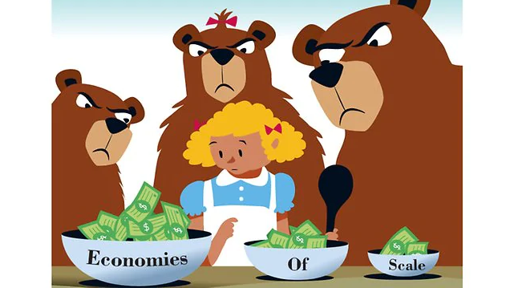
Economies of Scale

Slide 2
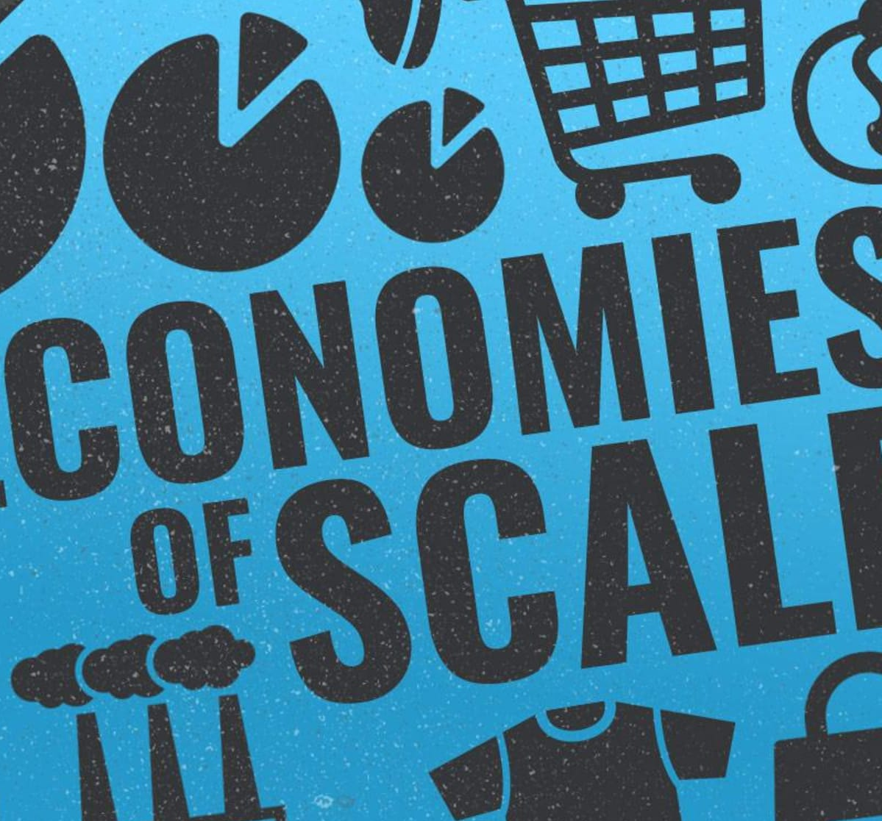
Economies of Scale
What are economies of scale?
Time is of importance:
  Short run: a period during which at least one factor of production is fixed. If capital is fixed, then more output is produced by using additional labour.
  Long run: a period of time that is sufficient to enable all factors of production to be adjusted. A producer can hire more labour immediately, if necessary, by taking on new workers or getting existing workers to work longer hours.
Economies of scale exist in the long run
Economies of scale is a phenomenon that describes the descrease in production costs with a rise in the size or scale of operation

Slide 3
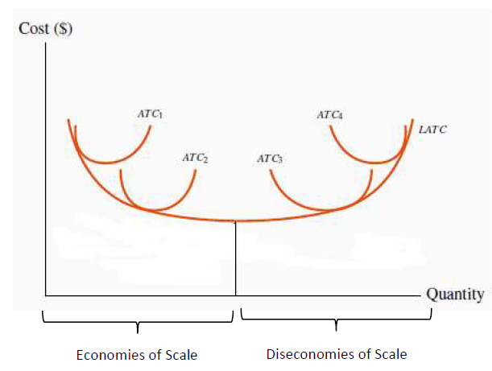
Economies of Scale: illustration
Notes:
This graph is adopted from Figure 8.5: Long-run and Short-run average costs in Principles of Microeconomics (2017 edition) by Douglas Curtis and Ian Irvine.

Slide 4

Economies of scale: why they exist?
When long-run average total costs decline with output increase, the firm is experiencing economies of scale.
Why do economies of scale arise?
  Increased specialization – as larger scale of operation means that individual workers can do more specialized tasks, becoming more skilled/efficient

Slide 5
Economies of scale: summary
Refer to the YouTube video on UR courses for a brief overview of various economies of scale
What types of economies of scale are there?

Slide 6

Diseconomies of scale: definition
In many production environments, beyond some large scale of operation, it becomes increasingly difficult to reap further cost reductions from specialization, organizational economies, or marketing economies.
At this point, scale economies are effectively exhausted, and larger plant sizes no loner give rise to lower (short-run) ATC curves.
When we continue to expand, we may almost exhaust the possibilities of further scale advantages.
If we increase the scale of a firm to extremely high output levels, we are actually encountering diseconomies of scale.
Diseconomies of scale imply that unit costs increase as a result of the firm’s becoming too large.

Slide 7

Reasons for diseconomies of scale
When a firm becomes too large:
Co-ordination difficulties can set in at very high output levels
Quality-control monitoring costs rise
Are these challenges pertinent to government production? Can governments experience diseconomies of scale?

Slide 8

Learning Outcomes
Economies of scale: definition, meaning, importance
Diseconomies of scale: definition and reasons why diseconomies exist

