Slide 1
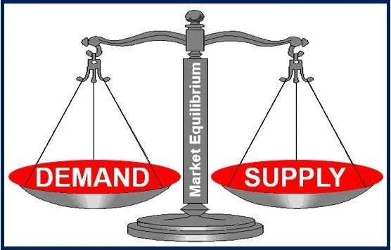
Market Equilibrium

Slide 2
Market Building Blocks
Demand is the quantity of a good or service that buyers wish to purchase at each conceivable price, with all other influences on demand remaining unchanged.
  So far, we have focused on the demand of one individual
  Market demand is the collection of many individual demands represented as a schedule of quantities demanded at various prices
Supply is the quantity of a good or service that sellers are willing to sell at each possible price, with all other influences on supply remaining unchanged.
  So far, we have focused on the supply of a single producer
  Market supply is the collection of many producer supplies represented as a schedule of quantities supplied as different prices.

Slide 3
Market Equilibrium
Demand and supply schedules rest on the assumption that all other influences on supply and demand remain the same as we move up and down the possible price values.
The expression other things being equal, or its Latin counterpart ceteris paribus, describes this constancy of other influences.
We assume on the demand side that prices of other goods remain constant, and tastes and incomes are unchanged.
We assume on the supply side that there are no technological changes in production methods.
If any of these elements change then the market supply or market demand schedules will reflect such changes.

Slide 4
Market Equilibrium
Bringing the demand and supply schedules together, we can analyze what the marketplace will produce. Ceteris paribus, at low prices, quantity demanded exceeds quantity supplied. The opposite happens when prices are high.
When the quantity demanded equals the quantity supplied, the market is in equilibrium. The equilibrium price equates quantity demanded and quantity supplied– it clears the market.

Slide 5
Market Equilibrium
Excess supply exists when the quantity supplied exceeds the quantity demanded at the going price.
  This happens at higher prices – suppliers wish to sell more than buyers wish to buy
Excess demand exists when the quantity demanded exceeds the quantity supplied at the going price.
  This happens at lower prices – buyers wish to purchase more than suppliers wish to produce
Only at equilibrium price is the quantity supplied equal to quantity demanded.

Slide 6
Market Equilibrium
Reaching market equilibrium:
If the producer chooses a price that is too high, there will be no buyers – a situation of extreme excess supply.
When producers lower the price, the excess supply will decrease because the quantity demanded increases, and the producer will supply less.
Excess supply means there are producers willing to supply at a lower price, which puts downward pressure on any price above the price that equates demand and supply.
Prices below the equilibrium conversely create an excess demand. Suppliers could force the price upward, knowing that buyers will continue to buy at a price producers are willing to sell at.
This upward pressure on price would continue until the excess demand is eliminated.

Slide 7
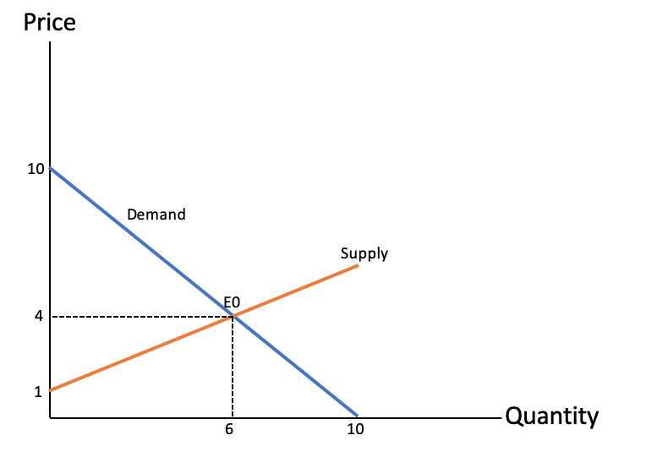
Market Equilibrium: Illustration
Notes:
This graph is adopted from Figure 3.2: Supply, demand and equilibrium (pg. 49) in Principles of Microeconomics (2017 edition) by Douglas Curtis and Ian Irvine.
To summarize:
Above the equilibrium price, excess supply puts downward pressure on price.
Below the equilibrium price, excess demand puts upward pressure on price.
Buyers and sellers have information on the various elements that make up the marketplace.
The intersection of the demand and supply curve at point E0 is the equilibrium price for this market ($4).
At any point below this (price below $4) , the horizontal distance between the supply and demand curve represents excess demand, because demand exceeds supply.
At any price above $4, there is an excess supply measured by the horizontal distance between the two curves.
Market forces tend to eliminate excess demand and excess supply, as we have previously learned.

Slide 8
Example: Housing market in a small Montreal community
Demand and supply curves frequently shift at the same time. Lets consider an example of the housing market in a small Montreal municipality
Setting the stage:
There are a fixed number of homeowners that decide to put their house on the market. They are considered the suppliers in the housing market.
Fewer houses were offered for sale in 2002 (less than 50) than in 1997 (more than 70).
Houses for sale were similar (mansions are excluded).
Household income increased substantially in this time period, and mortgage rates fell. These developments increased the demand for housing. Buyers were willing to pay more for housing in 2002 than in 1997, they had higher income and could borrow more cheaply.

Slide 9
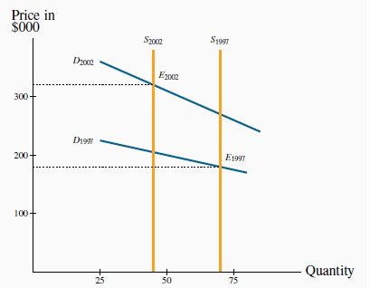
Example: Housing market in a small Montreal community
Notes:
This is Figure 3.5: A model of the housing market with shifts in demand and supply (pg. 57) in Principles of Microeconomics (2017 edition) by Douglas Curtis and Ian Irvine.

Slide 10
Example: Housing market in a small Montreal community
The shifts on both sides of the market resulted in a higher average price. And each of these shifts compounded the other:
The outward shift in demand would lead to a higher price on its own, and a reduction in supply would do likewise. Both forces acted to push up the price in 2002.
If, instead, the supply had been greater in 2002 than in 1997 this would have acted to reduce the equilibrium price.
With the demand and supply shifts operating in opposing directions, it is not possible to say in general whether the price would increase or decrease.

Slide 11
Cheat sheet for simultaneous supply and demand impacts
 | Increase in Demand | Decrease in Demand
Increase in Supply | Price Inconclusive | Price Falls
 | Quantity Rises | Quantity Inconclusive
Decrease in Supply | Price Rises | Price Inconclusive
 | Quantity Inconclusive | Quantity Falls

Slide 12

Learning Outcomes
Market demand and market supply
Other things being equal
Equilibrium price
Market equilibrium

