Slide 1

Market Power

Slide 2

Why study market power?
Market power is the firm’s ability to affect the market price.
This ability depends on the type of the firm, or market structure.
Understanding market structure is important for the following reasons:
  Economic: market structure affects market outcomes through its impact on the motivations, opportunities and decisions of economic actors participating in the market (buyers and sellers).
  Government policy: depending on the market structure, governments will attempt to combat inequities/promote fairness through regulation and fiscal instruments.

Slide 3
What is market structure?
Market structure is defined as a set of characteristics of the market that influence the behaviour of the firms working in that market.
Four most recognized market structures are:
Perfect competition and monopoly are extremes in the marketplace. Most sectors of the economy lie somewhere between these extremes.
Perfect Competition | Monopolistic competition | Oligopoly | Monopoly

Slide 4

Perfect Competition
A competitive market encompasses a very large number of suppliers. These suppliers:
Produce similar or identical products;
Produce an output that forms a small part of the total market;
Face many buyers;
No one participant can influence the market on their own.
Maximize profit, just like we discussed in earlier lessons.

Slide 5
Perfect Competition
The presence of many sellers in perfect competition means:
Each firm recognizes its own small size in relation to the total market.
Actions of these firms have no impact on the market price of the good or service being traded.
Each firm is a price taker – in contrast to a monopolist who is a price setter.
‘Smallness’ and the demand of individuals:
Each buyer takes the price that is given. He or she is not big enough to influence the price.
In contrast, large firms like airlines that purchase or lease from Boeing or Airbus, are able to negotiate over the price and other conditions of supply.

Slide 6
Understanding competition
There are several providers in the smartphone market, but it is dominated by two major players: Apple & Samsung. So, while these markets that have a limited number of suppliers are competitive in that they freely/fiercely compete for buyers, they are not perfectly competitive because they do not have a large number of suppliers.
When we describe a market as being perfectly competitive, we do not mean that other market types are not competitive; all market structure are competitive in the sense that the suppliers wish to make profit, and they produce as efficiently as possible in order to meet that goal.

Slide 7
Five Key Attributes of a Perfectly Competitive Market
There must be many firms, each one small and powerless relative to the entire industry.
The product must be standardized. Barber shops offer a standard product, but a Lexus differs from a Ford. Barbers tend to be price takers, but Lexus does not charge the same price as Ford, and is a price setter.
Buyers are assumed to have full information about the product and its pricing. For example, buyers know that the products of different suppliers really are the same in quality.
There are many buyers.
There is free entry and exit of firms. As long as economic profits exist, new firms will enter and the resulting increase in supply will continue to drive the price downwards. Once the price has been driven down to the minimum of the ATC of a representative firm, there is no longer an incentive for new entrepreneurs to enter.

Slide 8
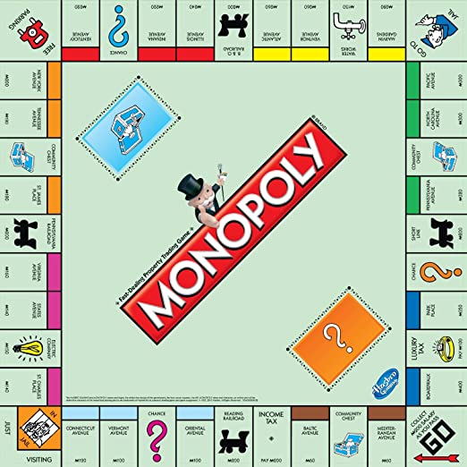
Monopoly
A market that has a single supplier is a monopolist.
The National Hockey League is the sole supplier of top-quality professional hockey games in North America.
In some sectors of the economy, monopolies arise naturally. These monopolies are known as natural monopolies.
  Technical definition of a natural monopoly: is one where the average total cost of producing any output declines with the scale of operation.
Sometimes it is national policy for monopolies to exist

Slide 9



Examples of natural monopolies
Electricity distribution in most of Canada’s provinces is in the hands of a single supplier:
Hydro Quebec or Hydro One in Ontario. These distributors are natural monopolies, as unit distribution costs decline with size.
Past natural monopolies:
Bell Canada was considered to be a natural monopoly in the era of land lines: It would not make economic sense to run several sets of phone lines to every residence. But that was before the arrival of cell phones.
Canada Post was also thought to be a natural monopoly, until the advent of FEDEX, UPS and other couriers proved otherwise.

Slide 10
National Policy
Monopolies can also arise as a result of national policy.
Some governments are proud to have a ‘national carrier’ in the airline industry – Air Canada in Canada or British Airways in the UK.
The mail service was viewed as a symbol of nationhood in Canada and the US: Canada Post and the US Postal system are national emblems that have historic significance.
National policy is costly to taxpayers:
Industries not subject to competition can become expensive.
Managers have insufficient incentives to curtail costs.
Unions realize the government is committed to sustain the monopoly and push for higher wages than under a more competitive structure.

Slide 11
Four Key Attributes of a Monopolistic Market
One very large firm, no competitors
Unique nature of the product
Significant barriers to entry – via patents/copyrights, prevent other firms to enter
Price setters – this can lead to inefficiency requiring government intervention
Notes:
Cartels can act as monopolists
A cartel is a group of suppliers that colludes to operate like a monopolist
The cartel formed by the members of the Organization of Oil Exporting Countries (OPEC), is an example of a cartel that was successful in collusion.
In 1973, they increased the world price of oil from $3 to $10 per barrel
This resulted in billions of dollars transfers from the energy-importing nation in Europe and North America to OPEC members.
Since the demand for oil is relatively inelastic, an increase in price increases total expenditures.
A second renowned cartel is managed by De Beers, which controls a large part of the world’s diamond supply.

Slide 12
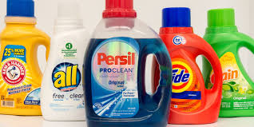
Key Attributes of a Monopolistically Competitive Market
Monopolistic competition describes a large number of small producers or suppliers that have slightly differentiated products.
  A local coffee shop that serves “fair trade” coffee, sells slightly different product than their neighbour who sells traditional coffee.
Firms are in the same sector but have different prices.
Only some barriers to entry
Each firm can influence its market share to some extent by changing its price.
  A pasta special at an Italian restaurant that reduces price below that of the competing Thai restaurant will draw clients away from the latter, but the foods are sufficiently different, so only some customers will leave the Thai restaurant.

Slide 13
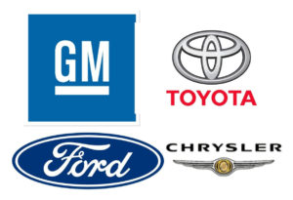
Key Attributes of an Oligopolistic Market
Under perfect competition or monopolistic competition, there are so many firms in the industry that each one can ignore the immediate effect of its own actions on particular rivals.
In an oligopolistic industry, each firm must consider how its actions affect the decisions of its relatively few competitors.
Oligopoly defines an industry with a small number of suppliers.
Other characteristics of oligopolistic firms:
  Firms are large
  Significant barriers to entry
  Similar products across small number of firms

Slide 14

Learning Outcomes
Definition of market power and market structures
Characteristics of four market structures: perfect competition, monopolistic competition, oligopoly and monopoly

