Slide 1


Public Policy for Fairness and Efficiency

Slide 2
Objectives for this session
Economists stress that there are always trade-offs. A key trade-off in policy is the one between efficiency and fairness. And policies are evaluated based on whether their intended outcomes are efficient and fair.
The objectives is to tackle the following questions:
  What are the goals of public policy?
  What constitutes an efficient outcome? A fair outcome?
  How can game theory address the trade-off between efficiency and fairness?
A major challenge for economists and policy makers is understanding people’s responses to policies so these responses can inform policy-making.

Slide 3


Public Policy Goals
Promoting gains for all
Correcting unfairness

Slide 4
What is efficient? What is fair?
Efficiency addresses the question of how well the economy’s resources are used and allocated.
Fairness deals with how society’s goods and rewards are, and should be, distributed among its different members, and how the associated costs should be apportioned.
Outcome: who does what & who gets what
Is the outcome efficient? Could there be mutual gains from moving to some other allocation?
Is the outcome fair? Is there some allocation that would be fairer? Are the rules of the game that produced the allocation fair?

Slide 5
Side note: What else do we value?
As a society, we place great value on fairness and efficiency, and evaluate policies according to these two values
However, other values can be used to evaluate an economic outcome:
  Individual dignity
  Freedom
  Diversity
  Religion/ Values

Slide 6
Taking a closer look at efficiency
Efficiency describes the absence of waste or the appropriate use of resources to accomplish something.
For example, a society would not be using its water resources efficiently if the water was wasted through leaky pipes.
A community would be operating inefficiently if some people did not have access to clean drinking water, while others had well-watered golf courses.

Slide 7
Pareto efficiency
Economics language:
An outcome is Pareto efficient if there is no other outcome that would be preferred by everyone affected.
Everyday language (example):
“This is not a sensible way to utilize scarce water – it is inefficient”
Synonyms: deadweight loss, waste, throw away
Does efficiency say anything about fairness?

Slide 8
Taking a closer look at fairness
Being fair does not mean automatically compensating losers:
Suppose a hospital in Europe, funded by general taxation, has an opportunity to have its X-rays examined by qualified radiologists in Asia. This is cheaper for the hospital, which is short on funding.
Are there losers? Yes. Well-paid radiologists in the hospital lose a small part of their income as a result. They ask the government to compensate them.
While it is possible for policymakers to replace lost income, should they?
Knowing winners and losers:
If the policy is evaluated on the grounds of fairness, and doctors are known to be well-off, then they don’t need to be compensated. Compensate only those that are not well off.

Slide 9

Side note: equality vs. equity
Fairness can be achieved by treating everyone exactly the same – for example, an equal amount of time to finish the test
This is equality. Equality fails to take into account that not everyone starts from the same place and people need different supports than others do.
Equity, on the other hand, promotes giving everyone equal access to the same opportunity.
https://mostly.ai/2020/05/06/we-want-fair-ai-algorithms-but-how-to-define-fairness/

Slide 10
Evaluating an Outcome: Is it Fair?
Too much inequality?
With too much inequality, many see it as a problem.
Distribution of wealth in the US – example
Michael Norton and Dan Ariely performed a study asking a large number of Americans what fraction of wealth should go to the wealthiest 20% and to estimate what they thought the distribution of wealth actually was.
Results:
Ideal: The richest 20% should own a little more than 30% of total wealth – some inequality was desirable, but not a lot.
Estimated: Americans thought the top 20% owned about 60% of wealth
Actual: The top 20% own 85% of wealth.

Slide 11
Evaluating an Outcome: Is it Fair?
Inequality or a tilted playing field?
Not all economic inequalities are unfair: Consider two twin brothers, one is a poet and part time primary school teacher, the other is an engineer who works 60 hours a week. Both had opportunities for good education:
The poet dropped out after 2 years
The engineer earned a post graduate degree and earns 3 times more than the poet.
Very few people would think the difference in income is unfair.
Comparing the brothers highlights the role of choices made by individuals who started on a level playing field.

Slide 12
Evaluating an Outcome: Is it Fair?
Different choices yield different incomes:
We can accept the data that the inequality between the two twins is not unfair: They were a product of the same parents, upbringing, schooling opportunities, and genetic code – the same would prove with twin sisters.
The inequality between brother and sister twins however could be deemed unfair as differences in come could be a result of gender discrimination.

Slide 13
Evaluating an Outcome: Is it Fair?
Study:
Christina Fong, an economist, wanted to know how people in the US think when it comes to their political support or opposition to policies to raise the incomes of the poor, financed by general taxation.
During a survey in 1998, respondents were asked the usual questions about their economic situation, and their opinion about why some people get ahead in life while others do not, and whether the government should introduce considerable taxes to redistribute income to the poor.
Results:
A person who thinks that hard work and risk-taking are essential to economic success is much less likely to support redistribution to the poor than a person who thinks the key to success is inheritance, being white, your connections, or who your parents are.
White people who think that being white is important to getting ahead strongly support redistribution to the poor—evidently because they think that the process that determines economic success is unfair.

Slide 14
Consumer Surplus and Producer Surplus
An understanding of efficiency is based on two related measures:
Consumer surplus: relates to the demand side of the market.
Producer surplus: relates to the supply side.

Slide 15
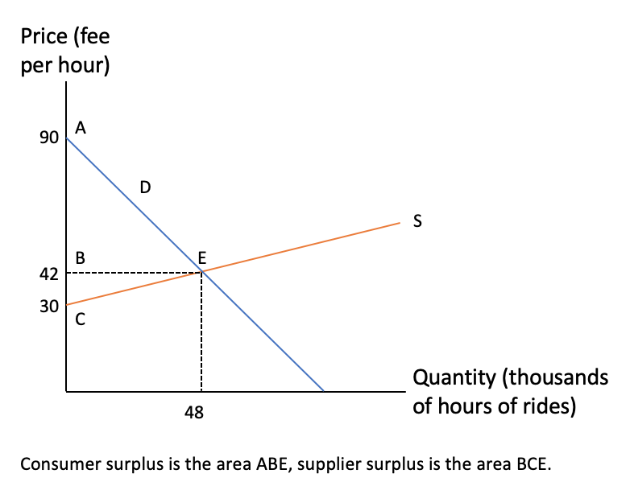
Taxi Market: Consumer and Producer Surplus
Let’s draw
Notes:
The demand curve represents the willingness to pay on the part of riders.
The supply curve represents the willingness to supply on the part of drivers.
The price per hour of rides defines the vertical axis.
Hours of rides in thousands are measured on the horizontal axis.
The demand intercept of $90 says that the person who values the ride most highly is willing to pay $90 per hour.
The downward slope of the demand curve states that other buyers are willing to pay less.
On the supply side, no driver is willing to supply his time and vehicle unless he obtains at least $30 per hour

Slide 16
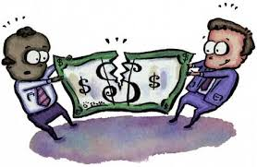
Fairness and Efficiency in the Ultimatum Game
The ultimatum game is a setting for observing social interactions
We can use the ultimatum game to study how efficiency and fairness interact
Subjects of the experiment play a game in which they will win money. How much they win, however, will depend on how they and the others in the game play.
Watch a video entitled “The Ultimatum Game” posted on UR courses
The video provides a detailed explanation of the ultimatum game
The video relates this game to government policy

Slide 17
Reflecting on the Ultimatum Game
Dividing something of value in equal shares (the 50–50 rule) is a social norm in many communities, as is giving gifts on birthdays to close family members and friends. Social norms are common to an entire group of people and tell a person what they should do in the eyes of most people in the community.
A Responder who thinks that the Proposer’s offer has violated a social norm of fairness, or that the offer is insultingly low for some other reason, might be willing to sacrifice their own payoff to punish the Proposer.

Slide 18
The Ultimatum Game and efficiency considerations
If you were a Responder who cared only about your own payoffs, you would accept any positive offer, because something is better than nothing.
If you cared about fairness too, and the Proposer made you a low offer that you considered unfair, you might reject the offer. Neither you nor the Proposer would receive anything. This outcome cannot be efficient.
How can the inefficiency be eliminated? Change the rules of the game so that a Responder, even one who cared very much about fairness, could not reject any offer. Dictator game – acting out of self-interest. Would this be fair?

Slide 19
Implementing Public Policies
Giving women the vote reduced child deaths in the US.
Requiring randomly selected Indian villages to be headed by women changed spending priorities in ways that benefited women.
Governments implement policies through some combination of:
Prohibitions and directives: Some actions can be simply directed by the government (sending your children to school) or prohibited (using leaded fuel for your car).
Incentives: A policy changes the benefits or costs of alternative courses of action open to the individual.
Making information available: People can use this information when they make decisions about which actions to take

Slide 20
Implementing Public Policies
There are limitations to policy making:
Imposing a speed limit on a highway does not always prevent people from driving fast.
It simply changes the environment in which driver’s decisions about how fast to drive occurs.
The outcome is not something the government can dictate.
It is the result of an interaction between the government’s actions (via a policy) and the privately chosen actions of those affected.
Nash Equilibrium: Explains how government policies can change economic outcomes by changing what actions people decide to take.
It is a set of strategies adopted by players such that each is a best response to the others, so that none of the players have an incentive to change their strategy.
Similar to Pareto Efficiency, it is a concept used in public policy analysis, but refers to an entirely different aspect of social interaction.

Slide 21
Unintended consequence of a redistributive tax
Governments raise taxes on profits of firms to fund new social programs that benefit the middle and lower class.
Say the new finance minister introduces a higher tax rate that will raise revenue by 50%:
He plans to spend the additional tax revenue on improvements in pre-primary schooling.
Owners of the firm protest against the new tax rate.
He learns that tax revenue is falling – 10% lower than last year.
When tax rates increased, firms hired tax lawyers to exploit loopholes in tax law.
When the government changed their tax regime, firms changes their strategies too.
Notes:
George Harrison objected to the taxman saying, in his words, ‘One for you, 19 for me,’ in the 1960s.
The Beatles hired an accountant who explained that if they formed a company, they would not have to pay the 95% marginal income tax, because company income was taxed at a lower rate than personal income.

Slide 22
Why Firms Hire Tax Lawyers?
The interaction between government policy and the firms is called the tax avoidance game:
It is played by the Government who will levy taxes and direct their uses
And the ‘Firm owner’ who will pay taxes on the profits accruing to the firm.
The Government would like taxes to be greater.
The firm would like profits after the payment of taxes to be greater.

Slide 23
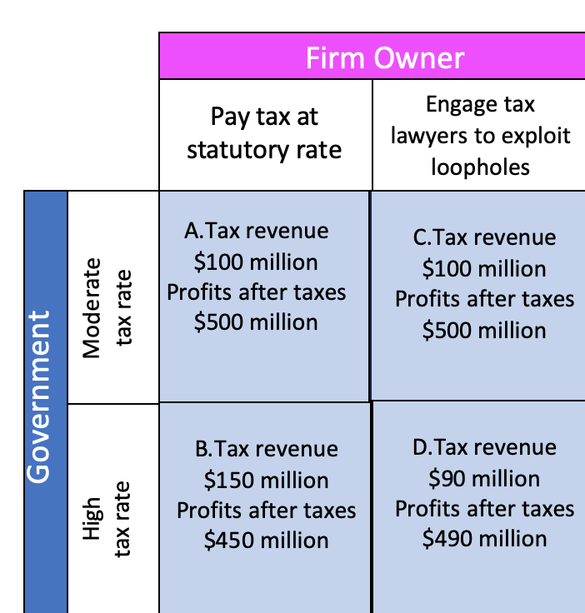
Why Firms Hire Tax Lawyers?
Nash equilibrium: Avoid taxes when the rate is high (case D)
At the higher tax rate, lawyers could reduce the Firm’s tax bill by $60 million—it falls from $150 million to $90 million. The profits would therefore be $490 million rather than $450 million.
Notes:
Each player only has 2 choices, and the actions open to the Government are not the same as the actions open to a private citizen or the owner of the Firm:
The Government: May levy either moderate taxes or high taxes on the Firm owner’s profits.
The Firm: Can either pay taxes at the statutory (government-intended) rate, or hire tax lawyers to exploit loopholes in the tax laws—finding accounting methods that will allow the Firm to ‘earn’ its profits in some other lower tax country, for example—so as to minimize its tax obligations.
Consider first what happens when the owner pays tax at the statutory rate:
When the tax rate is moderate: $100 million in tax is collected and the Firm’s profits are $500 million (the upper left cell, A).
At the higher tax rate: $150 million in tax is collected (lower left cell,
B) and profits fall to $450 million. This is what the finance minister
had expected to happen.

Slide 24
Why Firms Hire Tax Lawyers?
Point D is dominated by point A.
Sadly, both players are worse off at the Nash equilibrium D than they would have been if they had remained at A, with moderate taxes and no lawyers.
Because of their decisions, after-tax profits are lower and tax revenues are lower too.
Watch a video entitled “The Nath Equilibrium” posted on UR courses.
A successful policy must be a Nash equilibrium
The outcomes of policies are determined by the decisions of private actors as well as those government officials.
The outcome that the government wants must be a Nash equilibrium. Otherwise, it will not last.

Slide 25
Real-World Policy Design Problem
The question is: How do we work out the effect of a policy on outcomes?
So far, we assume that policymakers know the possible futures with certainty—how the policy will shift the Nash equilibrium, and what the outcome will be.
This meant we could fill in the payoffs in the payoff matrix.
However, the connection between the policy and the effect is rarely simple.
If the policy makes something illegal, such as banning the use of lead in petrol, we can assume it will be obeyed.
In most cases, we do not know with this level of precision what the impact of a policy would be.

Slide 26

Will the Policy Work?
It is hard to achieve precision of the impact:
If a tax is imposed on sugary drinks to discourage obesity and prevent diabetes, how do we know if people will drink tomato juice instead, or just switch to eating more chocolate to get their sugar?
We also do not know how the effect might differ among, say, the rich and poor.
The effect of a policy often depends on the actions taken by millions of people.
We could ask each of them, ‘If a soft drink were to cost you an additional euro per can, how would that change the amount you drink in a week?’
We should not be confident that we would get a reliable answer.

Slide 27
Policy Evaluation
It is difficult to distinguish between the effects of the policy under consideration and the effects of other things that happened to take place at the same time.
Goal is to identify causes than simply finding correlations
To narrow the range of uncertainty, economists typically look at what people do. We can examine the effects of similar policies adopted in the past, or by other bodies.

