Slide 1
Financial Empowerment for Indigenous and Non-Indigenous Peoples, 2nd Edition
University of Regina Open Education and Programming
E-Book Launch
November 28th, 2024

Slide 2
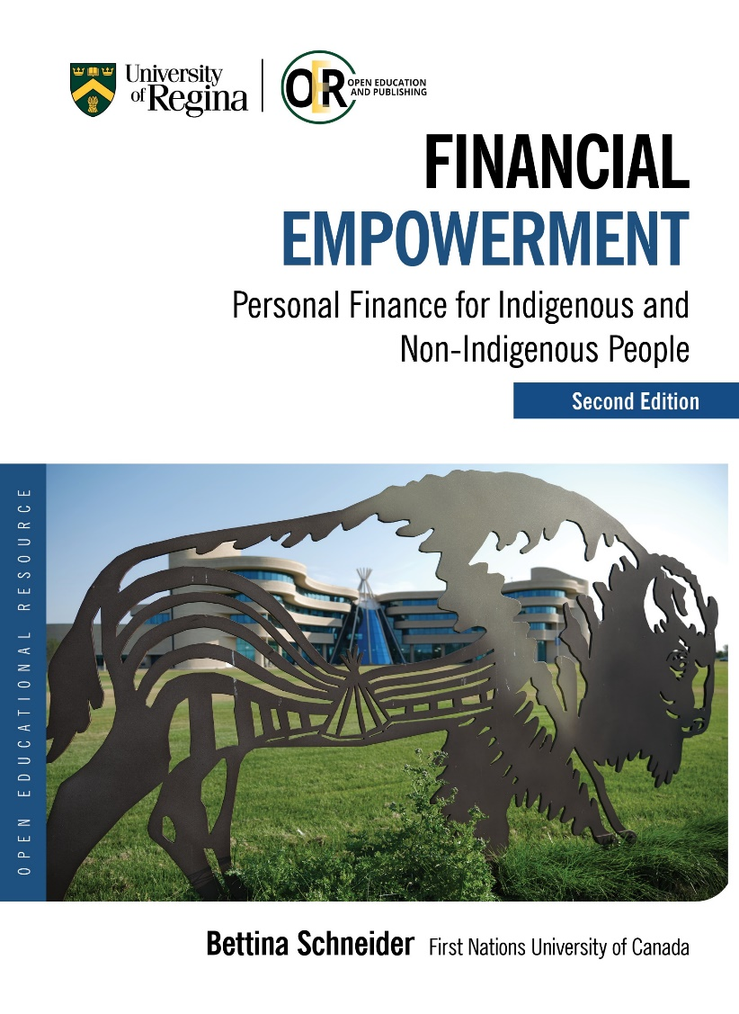
Financial Empowerment Text
Financial Empowerment: Personal Finance for Indigenous and Non-Indigenous People was first published in 2018 with the Support of the University of Regina (UofR) Press as part of the UofR Open Textbook Publishing Program in 2018.
The purpose of this textbook adaptation is to take an accessible, student-focused personal finance textbook written originally for an American audience and make it relevant for Indigenous and non-Indigenous people in Canada. In so doing, it aims to not only help students build their own personal financial capacity, but to prepare them to help others do the same.

Slide 3
Financial Empowerment Text
Financial Empowerment is designed to provide students with the necessary financial literacy skills needed to make good financial decisions, assess financial risk, and achieve financial success.
This textbook also attempts to speak to the varied backgrounds, knowledge systems, values, and experiences of Indigenous and non-Indigenous Canadians by providing a variety of perspectives on personal finance and financial planning using examples and information from Elders, Indigenous Nations and leaders, Indigenous and non-Indigenous organizations, various levels of government, the Canadian financial system, and the economy.

Slide 4
Financial Empowerment Text
It is important to understand our own values, histories, and life experiences in order to better understand our financial decision-making processes and how our values, histories, and life experiences shape our relationship to money and personal finance.
This text also explores not only how colonization denied many Indigenous people equal access to money, economic opportunities, and financial literacy education but also how they are thriving and overcoming such barriers.

Slide 5
Elder Interviews
Eight elders from FNUniv were interviewed as part of the adaptation of The Saylor Foundation’s Personal Finance open textbook.
The elder interviews are easily accessible through the textbook and can be accessed here: https://opentextbooks.uregina.ca/financialempowerment/back-matter/video-interviews-with-elders/
Let’s take a look at an interview with Elder Rose Bird who explains how she learned how to budget.

Slide 6
Indigenous Teachings re Financial Management
The late Elder Florence Allen shared, “The first teachings I got regarding finance were through my parents and there is one that sticks out a lot. They said money has a purpose and you’re always the boss of it and it’s never the boss of you because if it becomes the boss of you, you become obsessed about it and you hoard it and you are not as kind” (personal communication, June 10, 2017).
When talking about her parents, Elder Florence Allen said, “They only went as far as the money went. . . . We never suffered because of that. . . . Life is good when you know you can work with that money and not allow that money to take over your life” (personal communication, June 10, 2017).

Slide 7
Indigenous Teachings re Financial Management
Simon Brascoupé states, “The land is our teacher. It teaches us about saving, sustainability and security. At creation animals, birds and fish were asked what they could teach humans. The animal worlds said humans can learn from our values, character, and behaviour” (AFOA Canada, Prosper Canada, n.d.).
One example of learning from the animal world, shared by Prosper Canada and AFOA Canada (n.d.) is how "the chickadee saves 60,000 seeds for the long winter."

Slide 8
Learning from the Land and Animals
Acorn woodpeckers drill 50,000 holes into a single tree in the fall and will all store acorns in the tree to survive the winter, often having to leave their breeding ground if they are not able to store enough (Cornell Lab of Ornithology, 2024).
These teachings are all around us, yet many do not acknowledge the land and animals as some of our greatest teachers when it comes to financial management.
One bison could provide between 400 to 550lbs worth of meat, tipi covers, blankets, storage bags, sinew for sewing or securing items, bones that were carved into tools, horns that were used as spoons or cups (Markewicz, 2017).

Slide 9
Traditional Resource Management
The Building Native Communities financial literacy curriculum, produced by First Nations Development Institute and First Nations Oweesta Corporation, places great emphasis on traditional resource management as a financial literacy concept; it teaches us how “our actions today affect the resources that we will have available in the future” (FNDI and FNOC, 2015, p. 74).
Notes:
As Oweesta and First Nations Development Institute point out, “For years, our people have understood and practiced the present-day concepts of budgeting and savings. We managed our resources through conservation so that they lasted throughout the year by saving additional supplies for future use. Our people also saved for the purpose of acquiring goods that we could not produce ourselves. By producing more than the community needed, we had goods to trade,” (First Nations Development Institute First Nations Oweesta Corporation, 2015, p. 1).

Slide 10
Traditional Resource Management
Both FNDI and FNOC have written extensively about the long history of traditional resource management in Indigenous communities, comparing it to financial management today.
As stated in the Building Native Communities financial literacy curriculum, produced by FNDI and FNOC, “For years, our people have understood and practiced the present-day concepts of budgeting and savings. We managed our resources through conservation so that they lasted throughout the year by saving additional supplies for future use. Our people also saved for the purpose of acquiring goods that we could not produce ourselves. By producing more than the community needed, we had goods to trade,” (FNDI and FNOC, 2015, p. 1).
Notes:
As Oweesta and First Nations Development Institute point out, “For years, our people have understood and practiced the present-day concepts of budgeting and savings. We managed our resources through conservation so that they lasted throughout the year by saving additional supplies for future use. Our people also saved for the purpose of acquiring goods that we could not produce ourselves. By producing more than the community needed, we had goods to trade,” (First Nations Development Institute First Nations Oweesta Corporation, 2015, p. 1).

Slide 11
Budgets
Budgets lay out a plan and usually have a specific goal in mind: to cut living expenses, to increase savings, or to save for a specific purpose, e.g. education or retirement.
The budget is more a document of action while financial statements are more reflective what has already happened and the results of financial decisions.
According to the text, a budget is meant to be a reconciliation of ‘facts on the ground’ and ‘castles in the air’ and must be constantly revised to reflect new information.

Slide 12
Budget Process
The budget process involves:
defining goals and gathering data;
forming expectations and reconciling goals and data;
creating the budget;
monitoring actual outcomes and analyzing variances;
adjusting budget, expectations, or goals;
redefining goals.
Immediate and longer-term budget goals are arrived at when we review our financial statements or current financial condition as well as our own ideas on how we could be living.
Budget projections must be realistic, conservative and a constant compromise between one’s financial realities and goals.

Slide 13
Key Takeaways from Text
A budget is a process that mirrors the financial planning process and can help to capture one’s goals, behaviors, and limitations.
For the budget to succeed, goals and behaviors must be reconciled.
Budgets should be prepared conservatively.
Overestimate costs.
Underestimate earnings.
The appropriate time period should be short enough to limit the amount of data, but long enough to capture meaningful data.

Slide 14
Comprehensive Budgets
A comprehensive budget covers all aspects of financial life and should include a projection of recurring incomes and expenses and of nonrecurring expenditures.
Recurring incomes would be earnings from wages, interest, or dividends.
Recurring expenditures may include living expenses, loan repayments, and regular savings or investment deposits.
Nonrecurring expenditures might be the purchase of a new fridge or perhaps your roof needs to be replaced.

Slide 15
Operating Budgets
An operating budget is for short-term goals involving recurring items and a capital budget is for long-term goals involving nonrecurring items.
An income statement shows incomes and expenses; cash flow statements show actual cash expenditures.
It is important to note which incomes and expenditures recur reliably but only periodically or seasonally.
For personal budgets, a month is the most common budget period to use, however, a year of data is preferred in order to account for seasonal and periodic income and expenses (Schneider, 2024).

Slide 16
Using Micro and Macro Factors
Individual factors, such as age, health, career choices, family structure, must be taken into consideration when creating a budget.
Macro factors, such as unemployment (impact on wages), inflation, deflation and economic cycles, must also be factored into budgeting.
Macro factors become more influential in the assessment of your financial goals as you get closer to your goals.
Time value of money can help you to calculate capital expenditures and progress toward long-term goals. For example, knowing how much time there is and how much compounding there can be to turn your account balance (the present value) into your savings goal (its future value).
Let’s take a look at Jeff and his budgeting process.

Slide 17
Capital Budget
Free cash flow is the income remaining after the deduction of living and debt expenses.
Free cash flow can be used for capital expenditures (funds to acquire or upgrade assets) or investments.
Remember, assets are resources that can be used to create income, decrease expenses, or store wealth as an investment.
Capital expenditures and investments are usually part of a long-term plan of building an asset base.
Investment may also be part of a longer-term plan to achieve a specific goal such as financing education.

Slide 18
Key Takeaways from Text
A comprehensive budget consists of an operating budget and a capital budget.
• The operating budget accounts for recurring incomes and expenses.
Recurring incomes result from selling labor and/or liquidity.
• Recurring expenses result from consumption of goods and/or services.
• Recurring incomes and expenses satisfy short-term, lifestyle goals, create free cash flow for capital expenditures.
• The capital budget accounts for capital expenditures or nonrecurring items.

Slide 19
Key Takeaways from Text
Capital expenditures are usually part of a longer-term plan or goal.
• Projecting recurring incomes and expenses involves using financial history, new information and microeconomic factors, macroeconomic factors.
• Different methods may be used to project different incomes and expenses depending on the probability, volatility, and predictability of quantity and price.
• Projecting capital expenditures involves using the following:
New information and microeconomic factors
Macroeconomic factors (when closer to goal)

Slide 20
Cash Budget
When it comes to cash flow, timing is everything.
Cash flow may be regular or seasonal. When cash flow is not regular, a closer look at cash flow management is necessary.
Most expenses must be paid on a monthly basis, and if some income is irregularly received (e.g. seasonal), there is a risk of running out of cash in a specific month.

Slide 21
Cash Budget
Let’s look at Jeff’s cash flow.
As the text points out, the monthly cash budget shows a different story than the annual budget because of the seasonal nature of Jeff’s incomes.
Since Jeff is planning his capital expenditures before he begins to earn income from painting, he actually has to borrow more—and assume more risk.
If he delays the new roof until October, he will borrow less and will therefore pay less.

Slide 22
Budget Variance
Budget variance occurs when the actual results of your financial activity differ from your budgeted projections (Schneider, 2018).
Variances alert you to the fact that adjustments are needed and provide new information to assess your situation.
Variances occur because either your estimate was inaccurate or because certain macro- and micro-factors changed unexpectedly.

Slide 23
Budget Variance
Eventually, data replaces projections and constant monitoring and comparing to actual activities is needed.
Once you discover a budget variance, you need to analyze the variance to determine what caused it and adjust.
If the price of gas dramatically increases, you will need to adjust accordingly. You might:
spend less for other expenses in order to keep your total expenses within your budget,
lower your gas expense by driving less, and/or
increase your income.

Slide 24
Key Takeaways from Text
Recognizing and analyzing variances between actual results and budget expectations identifies potential problems, identifies potential remedies.
The more frequently the budget is monitored, generally the sooner adjustments may be made, the less costly adjustments are to make.
Budget variances for incomes and expenses should be analyzed to see if they are caused by a difference in actual quantity, actual price, both actual quantity and actual price.
Variances also need to be analyzed in the context of micro and macro factors that may change.

Slide 25
Destigmatizing conversations about money
The Financial Consumer Agency of Canada (FCAC) has just launched a Canada-wide campaign to destigmatize conversations about money.
The FCAC states that “many Canadians find it difficult to discuss money and finances with family and friends for fear of being judged. To overcome this taboo, FCAC is encouraging Canadians to share their financial experiences with family and friends, ask questions, and consult with trusted financial professionals.”
During yesterday’s FCAC Financial Literacy Month launch, Millie Acuna with SEED Winnipeg discussed the importance of a tailored approach and storytelling when it comes to teaching and talking about financial literacy. “Everyone has a very unique story.” “The most powerful tool is the power of storytelling.”

Slide 26
Financial Empowerment
Financial empowerment includes learning from both our past and present, becoming more aware of our values and attitudes regarding money and how they influence our financial behaviours, applying this awareness as well as our skills and knowledge to our present situations so that we can plan for our financial futures and achieve financial independence and well-being.
Financial empowerment is an approach that entails not only building one's personal finance skills and knowledge, but also changing one's financial behaviour in order to feel confident in making good financial decisions.
In order to change our financial behaviour, it is critical that we understand our values regarding money. As noted by FNDI and FNOC, “it’s difficult to manage money well unless you know your values surrounding money” (FNDI and FNOC, 2016, p. 18).

Slide 27
Financial Empowerment
In the text and in the class, I ask students the following questions:
What are your values around money? What is your money culture?
"Money culture” is defined by FNDI and FNOC as what we incorporate from our values, attitudes, goals, and practices into how we manage or view the importance of money (FNDI and FNOC, 2016).
In order to determine our money culture, we must look at the past, present, and future.
As AFOA BC states, “We need to acknowledge our past and understand how it influenced the present situation so we can move forward to creating our future” (AFOA BC, 2015, p. 6).

Slide 28
Conclusion
It is my hope that this 2nd edition of the textbook provides an accessible approach to financial literacy for Indigenous and non-Indigenous people across Canada—one that examines the past, present, and future, and which fosters financial empowerment for all.
Thank you for listening!

Slide 29
References
Aboriginal Financial Officers Association of British Columbia. (2011). First Nations Financial Fitness: Your Guide for Getting Healthy, Wealthy and Wise. Retrieved from: http://www.afoabc.org/wp-content/uploads/2015/06/financial-literacy-handbook.pdf
Collins, Dominique. (2011). Aboriginal Financial Literacy in Canada: Issues and Directions. Retrieved from: http://www.financialliteracyincanada.com/documents/consultation-2/Collin-09-02-2011-eng.pdf
First Nations Oweesta Corporation and First Nations Development Institute. (2016). Building Native Communities (5th Ed). Retrieved from:http://www.firstnations.org/system/files/BNC_Participant_5thEd_Small.pdf

Slide 30
References
Markewicz, L. (2017). "Like Distant Thunder: Canada’s Bison Conservation Story." Parks Canada. Retrieved from: https://parks.canada.ca/pn-np/ab/elkisland/nature/eep-sar/bison.
Prosper Canada and AFOA Canada. (n.d.). Managing your money: Tools and tips to help you meet your goals [Booklet].
Sinclair, M. (2024). Who We Are: Four Questions for a Life and a Nation. Penguin Random House: McClelland and Stewart.

