Slide 1
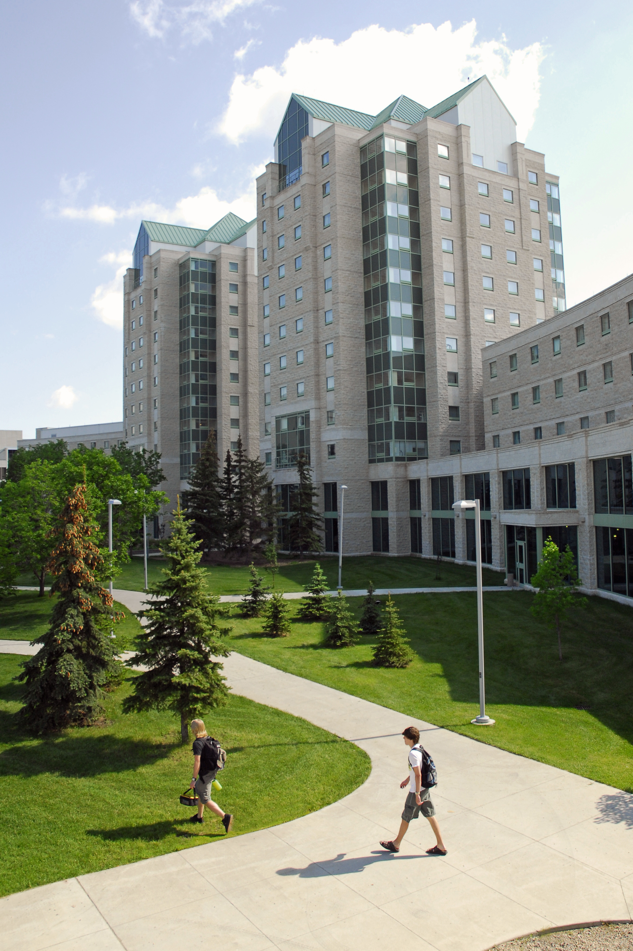

INCREASING INTERACTIVITY AND ENGAGEMENT USING H5P
JU
Rhett Danyluk

Slide 2

LAND ACKNOWLEDGEMENT
Image Source: https://www.convergingpathways.ca/treaty4/

Slide 3
AGENDA
Introduction to H5P
Why Use it?
Demonstration and Examples
When and When Not to Use it
Resources + Questions

Slide 4
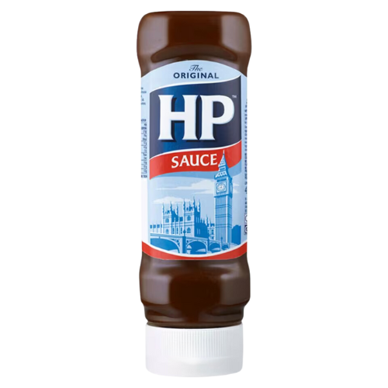

WHAT IS H5P?

Slide 5



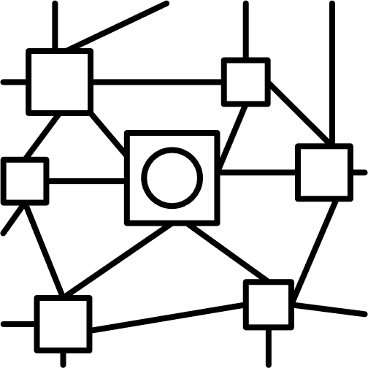

WHAT IS H5P?
HTML5 package
Browser Based tool
Over 50 content types
No coding

Slide 6


Encourages active learning
Integrates immediate feedback
Enhances engagement and retention
WHY USE H5P?
Reusable and sharable content
Wide applicability
Easy to Use

Slide 7

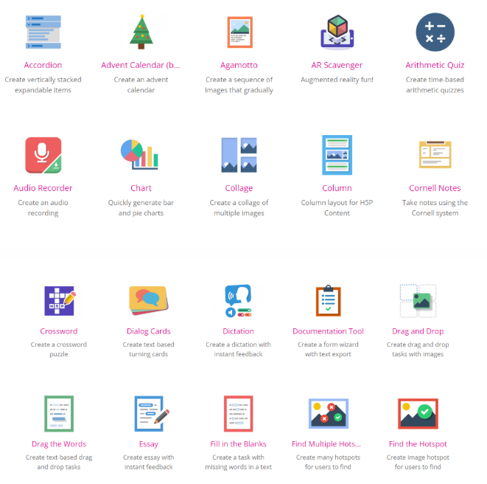

H5PS IN ACTION!

Slide 8




WHEN TO USE IT?
Formative Assessment
Highlight Important Concepts
Flipped classroom
Knowledge checks
Pre-assessment
Get students to practice material before the lesson
Active learning

Slide 9


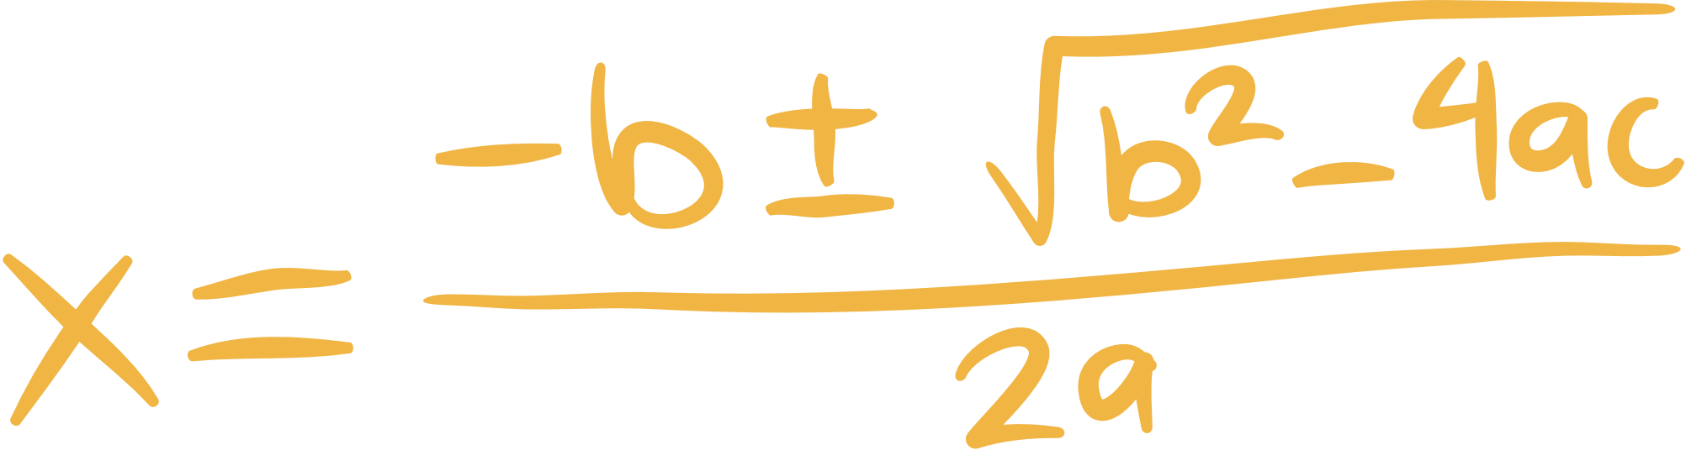
WHEN NOT TO USE IT?
Summative Assessment
Computational Questions
Accessibility concerns*
Some H5P content types are inaccessible.
Check accessibility
Provide alternatives
Unreliable at saving results
Accomodation issues
Difficult to implement manual formula marking

Slide 10




USING H5P

Slide 11

RESOURCES
Helpful Links
The Basics
Tutorials
Accessibility Guide
eCampusOntario H5P Studio
AI Prompt Recipes
H5P Difficulty Info
Resources

Slide 12
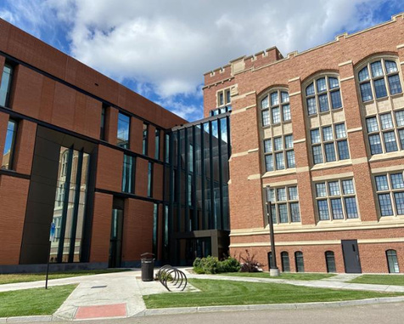



CONTACT
CCE Flexible Learning
306-585-5804
www.uregina.ca/continuing-education/index.html
Rhett Danyluk
Instructional Designer
rhett.danyluk@uregina.ca

