Slide 1
Identifying and Understanding How to Manage Conflict
Dispute Resolution Office, Ministry of Justice (Government of Saskatchewan)
Creative commons attribution 4.0 international license
June 2018

Slide 2
Open License
The PowerPoint slide deck created by Joan Wagner, and designed by JVDW Designs, for the open textbook Leadership and Influencing Change in Nursing is licensed under a Creative Commons Attribution 4.0 International License, except where otherwise noted. The University of Regina logo is a registered trademark.
Under the terms of the Creative Commons Attribution 4.0 International License, you are free to retain, reuse, copy, redistribute, and revise this PowerPoint – in whole or in part – as long as you provide attribution to Joan Wagner. Download the PowerPoint slide deck for Leadership and Influencing Change in Nursing by Joan Wagner for free at www.uregina.ca/open-access/open-textbooks.
For questions about University of Regina’s Open Textbook Publishing Program, contact: open.textbooks@uregina.ca.
CC BY 4.0 International License

Slide 3
Learning Objectives
Describe the different causes of conflict.
Analyze the different approaches to managing conflict.
Recognize how conflict escalates.
Adapt your approach to conflict.
CC BY 4.0 International License

Slide 4
The Theory of Conflict
Conflict: to struggle, clash, be incompatible (Oxford Dictionary, n.d.).
  For centuries, people accepted adversarial disputes and harsh conflict as a by-product of human nature.
  If we are to make progress toward better conflict resolution, we must understand:
    Why conflict arises; and
    How people have reacted to conflict situations.
CC BY 4.0 International License

Slide 5
Four Major Types of Conflict
Data Conflicts;
Relationship Conflicts;
Value Conflicts; and
Structural Conflicts.
CC BY 4.0 International License

Slide 6
Four Major Types of Conflict: Data Conflicts
Data conflicts occur when:
  People lack the information necessary to make wise decisions;
  People are misinformed;
  People disagree over which data are relevant;
  People interpret information differently; and
  People have competing assessment procedures.
CC BY 4.0 International License

Slide 7
Four Major Types of Conflict: Relationship Conflicts
These problems often result in what have been called unrealistic or unnecessary conflicts.
They occur due to the presence of strong emotions (e.g., jealousy, mistrust, hatred) and are created from perceptions, poor communication, stereotypes, and so on.
Relationship conflicts often fuel disputes, causing them to escalate.
CC BY 4.0 International License

Slide 8
Four Major Types of Conflict: Value Conflicts
This type of conflict is caused by perceived or actual incompatible value systems.
Value conflicts occur only when people attempt to force their set of values onto others.
CC BY 4.0 International License

Slide 9
Four Major Types of Conflict: Structural Conflicts
Structural conflicts are caused by oppressive patterns of human relationships.
These patterns are often shaped by forces external to the people in dispute.
Often, these conflicts can be overcome by identifying the structural problem and working to change it.
CC BY 4.0 International License

Slide 10
DATA | VALUES
Conflicts stem from: Lack of information Different information Different interpretations of data Different assessment procedures | Conflicts relate to: Day-to-day values Self-definition
RELATIONSHIP | STRUCTURAL
Conflicts stem from: Misperceptions Stereotypes Poor communication | Conflicts relate to: How a situation is set up Who is involved in making decisions Geographical and physical relationships Unequal power and authority
CC BY 4.0 International License

Slide 11
Dealing with Conflict—Different Approaches
Every individual or group manages conflict differently.
Thomas and Kilmann (2017) suggest that in a conflict situation, a person’s behaviour can be assessed according to two factors:
  Commitment to goals or assertiveness—the extent to which an individual (or a group) attempts to satisfy his or her own concerns or goals.
  Commitment to relationships or co-operation—the extent to which an individual (or a group) attempts to satisfy the concerns of the other party, and the importance of the relationship with the other party.
CC BY 4.0 International License

Slide 12
Essential Learning Activity 11.3.1
For information on the Thomas-Kilmann Conflict Mode Instrument, see the Kilmann Diagnostics website.
CC BY 4.0 International License

Slide 13
Dealing with Conflict—Different Approaches (Cont’d)
Thomas and Kilmann use these factors to explain the five different approaches to dealing with conflict:
  Avoiding
  Competing
  Accommodating
  Compromising
  Collaborating
CC BY 4.0 International License

Slide 14
Dealing with Conflict—Different Approaches: Avoiding
Types of Avoidance | Results | Appropriate When
Physical flight Mental withdrawal Changing the subject Blaming or minimizing Denial that problem exists Postponement to a more appropriate time (which may never occur) Use of emotions | The dispute is not resolved Disputes often build up and eventually explode Low satisfaction results in complaining, discontentment, and talking back Stress spreads to other parties | The issue is trivial or unimportant or another issue is more pressing Potential damage outweighs potential benefits Timing for dealing with the conflict is inappropriate
CC BY 4.0 International License

Slide 15
Dealing with Conflict—Different Approaches: Competing
Types of Competing | Results | Appropriate When
Power of authority, position, or majority Power of persuasion Pressure techniques Disguising the issue Tying relationship issues to substantive issues | The conflict may escalate or the other party may withdraw Reduces the quality and durability of agreement Assumes no reciprocating power will come from the other side Increases the likelihood of future problems between parties Restricts communication and decreases trust | There are short time frames and quick action is vital Dealing with trivial issues Tough decisions require leadership
CC BY 4.0 International License

Slide 16
Dealing with Conflict—Different Approaches: Accommodating
Types of Accommodating | Results | Appropriate When
Playing down the conflict to maintain surface harmony Self-sacrifice Yielding to the other point of view | Builds relationships that will allow you to be more effective in future problem solving Increases the chances that the other party may be more accommodating to your needs in the future Does not improve communication | You are flexible on the outcome, or when the issue is more important to the other party Preserving harmony is more important than the outcome It’s necessary to build up good faith for future problem solving You are wrong or in a situation where competition could damage your position
CC BY 4.0 International License

Slide 17
Dealing with Conflict—Different Approaches: Compromising
Types of Compromising | Results | Appropriate When
Splitting the difference Exchanging concessions Finding middle ground | Both parties may feel they lost the battle and feel the need to get even next time No relationship is established although it should also not cause relationship to deteriorate Danger of stalemate Does not explore the issue in any depth | Time pressures require quick solutions Collaboration or competition fails Short-term solutions are needed until more information can be obtained
CC BY 4.0 International License

Slide 18
Dealing with Conflict—Different Approaches: Collaborating
Types of Collaborating | Results | Appropriate When
Maximizing use of fixed resources Working to increase resources Listening and communicating to promote understanding of interests and values Learning from each other’s insight | Builds relationships and improves potential for future problem solving Promotes creative solutions | Parties are committed to the process and adequate time is available The issue is too important to compromise New insights can be beneficial in achieving creative solutions There is a desire to work through hard feelings that have been a deterrent to problem solving There are diverse interests and issues at play Participants can be future focused
CC BY 4.0 International License

Slide 19
What does each Approach Need?
It is important to be flexible and shift your approach according to the situation and the other people with whom you are working.
Taking the wrong approach can escalate conflict, damage relationships, and reduce your ability to effectively meet goals.
We react with our most dominant style when we are under stress, but other styles can be learned and applied with practice and self-awareness.
CC BY 4.0 International License

Slide 20
What does each Approach Need? (Cont’d)
Avoiders may need to feel physically and emotionally safe. When dealing with avoiders, try taking the time to assure them that they are going to be heard and listened to.
Competitors may need to feel that something will be accomplished in order to meet their goals. When dealing with competitors, say, for example, “We will work out a solution; it may take some time for us to get there.”
Compromisers may need to know that they will get something later. When dealing with compromisers, say, for example, “We will go to this movie tonight, and next week you can pick.” (Be true to your word.)
CC BY 4.0 International License

Slide 21
What does each Approach Need? (Cont’d)
Accommodators may need to know that no matter what happens during the conversation, your relationship will remain intact. When dealing with accommodators, say, for example, “This will not affect our relationship or how we work together.”
Collaborators may need to know what you want before they are comfortable sharing their needs. When dealing with collaborators, say, for example, “I need this, this, and this. . . . What do you need?”
CC BY 4.0 International License

Slide 22
Essential Learning Activity 11.4.1
Take an online test by Bacal and Associates from their webpage Conflict Quizzes and Assessments to find out your preferred approach to conflict.
CC BY 4.0 International License

Slide 23
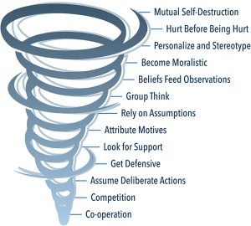
How Conflict Escalates
The information in this section has been adapted
from Speed Leas’ Levels of Conflict, published
by the Center for Congregational Health.
View section 11.5 for an example of an escalating
conflict.
Conflict Escalation Tornado
CC BY 4.0 International License

Slide 24
How to Get Off the Spiral: Stopping Escalation
An appropriate level of risk must be taken by the individuals involved to de-escalate a conflict.
By taking risks to de-escalate conflict, whether the result is successful or unsuccessful, the nurse leader sends a message that they want to rebuild trust, respect, and effective communication.
A nurse leader’s emotional intelligence plays an important role in the de-escalation of conflict.
When conflict is not de-escalated and resolved appropriately, it results in more conflict.
CC BY 4.0 International License

Slide 25
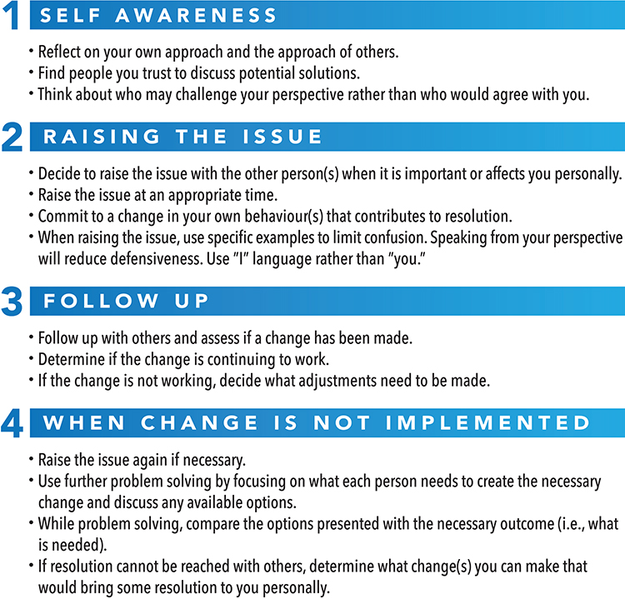
Content by the Dispute Resolution
Office, Ministry of Justice (Government of
Saskatchewan), designed by JVDW
Designs, and licensed under a CC BY 4.0
International License.
CC BY 4.0 International License

Slide 26
Research Note
Amestoy, S. C., Bakes, V. M. S., Thofehrn, M. B., Martini, J. G., Meirelles, B. H. S., & Trindade, L. L. (2014). Conflict in nursing management in the hospital. Revista Gaúcha de Enfermagem, 35(2). 79–85. doi:10.1590/1983-1447.2014.02.40155
The study outlined in this article takes a qualitative, descriptive approach. It includes case studies used as an investigational strategy to determine the main conflicts experienced by nurse leaders in the hospital environment, as well as the strategies adopted for dealing with them. Semi-structured interviews, non-participant observations, and dialogical workshops were used to collect data.
CC BY 4.0 International License

Slide 27
Research Note (Cont’d)
The study indicates that the most prevalent conflict in the health sector stemmed from the interpersonal relationships of those working in the health field. The study also emphasizes the power dynamics linked to the interpersonal conflicts.
The limitation of this study is that the availability and shift patterns of nurses make it difficult to perform the kind of involved research required for this study. However, this information will encourage the integration of interpersonal conflict management training into the work and training materials provided to nurses through their education.
CC BY 4.0 International License

Slide 28
Exercises for Review
Review the case scenarios and answer the questions associated with each scenario found at the end of chapter 11.
CC BY 4.0 International License

Slide 29
References
Amestoy, S. C., Bakes, V. M. S., Thofehrn, M. B., Martini, J. G., Meirelles, B. H. S., & Trindade, L. L. (2014). Conflict management: Challenges experienced by nurse-leaders in the hospital environment. Revista Gaúcha de Enfermagem, 35(2). 79–85. doi:10.1590/1983-1447.2014.02.40155
Leas, S. (2011). Levels of conflict. Center for Congregational Health. Retrieved from https://cntr4conghealth.wordpress.com/2011/09/01/levels-of-conflict-by-speed-leas/
Oxford Dictionaries online. (n.d.). Retrieved from https://www.oxforddictionaries.com/
Thomas, K. W., & Kilmann, R. H. (2017). An overview of the Thomas-Kilmann Conflict Mode Instrument (TKI). Kilmann Diagnostics. Retrieved from http://www.kilmanndiagnostics.com/overview-thomas-kilmann-conflict-mode-instrument-tki
CC BY 4.0 International License

Slide 30

Presenters
Presented by
Thank you!
Creative commons attribution 4.0 International license
June 2018

