Slide 1
Regulation, the Law, Labour Relations, and Negotiations
Beverly Balaski
Author’s Title
Creative commons attribution 4.0 international license
June 2018

Slide 2
Open License
The PowerPoint slide deck created by Joan Wagner, and designed by JVDW Designs, for the open textbook Leadership and Influencing Change in Nursing is licensed under a Creative Commons Attribution 4.0 International License, except where otherwise noted. The University of Regina logo is a registered trademark.
Under the terms of the Creative Commons Attribution 4.0 International License, you are free to retain, reuse, copy, redistribute, and revise this PowerPoint – in whole or in part – as long as you provide attribution to Joan Wagner. Download the PowerPoint slide deck for Leadership and Influencing Change in Nursing by Joan Wagner for free at www.uregina.ca/open-access/open-textbooks.
For questions about University of Regina’s Open Textbook Publishing Program, contact: open.textbooks@uregina.ca.
CC BY 4.0 International License

Slide 3
Learning Objectives
Identify the mandates of the provincial professional regulatory body, the union representing registered nurses, and the four national organizations (CNA, CFNU, CNPS, and CINA).
Compare and contrast each organization’s mission and approach to supporting Registered Nurses (RNs) and the delivery of quality nursing care.
Generate conclusions as to the current relevance of each organization.
Appraise how trends in health care are impacting the viability of these organizations.
Compare and contrast how these organizations are maintaining their current missions and roles or evolving to encompass new missions and roles.
CC BY 4.0 International License

Slide 4
Entry into the Profession of Registered Nursing
To practice as an RN, nurses:
  complete a program of study, and
  write and pass a national exam.
The license is issued by the regulatory body located in province where the nurse is working.
CC BY 4.0 International License

Slide 5
Regulation
Professional Self-Regulation:
  Self-regulation: the profession regulates itself through creation of a regulatory body, rather than being managed by government (CNA, 2007).
  The main responsibility of any professional self-regulatory body is to ensure protection of the public.
  Regulatory bodies achieve this mandate by ensuring that RNs are safe, competent, and ethical practitioners.
  In Canada, registered nursing is a self-regulated profession.
CC BY 4.0 International License

Slide 6
Regulation (Cont’d)
Standards recognize the unique and defined body of knowledge possessed by its members.
Main Functions of a regulatory body (Randall, 2000):
  setting requirements for individuals to enter the profession;
  setting requirements for the practice of the profession;
  setting up an investigation and disciplinary process; and
  setting up a process to evaluate the continuing competence of members.
CC BY 4.0 International License

Slide 7
Essential Learning Activity 15.2.1
View the links below to learn more about self-regulation and the necessary components of licensure, then answer the questions that follow.
SRNA’s “Position Statement on Profession-Led Regulation”
SRNA’s document “Our Role in the Public Interest”
  Why is self-regulation so important for the profession of nursing?
  Who do you think would regulate the nursing profession if nurses did not regulate it?
CC BY 4.0 International License

Slide 8
Trends in Nursing Regulation
Regulatory bodies encompassed both the college role (regulation of the profession) and the association role (advocacy for supporting RNs to inform and influence health care).
In recent years, governments, stakeholders, and the public have begun to question the benefit of one body holding responsibility for both regulatory administration and advocacy.
CC BY 4.0 International License

Slide 9
Essential Learning Activity 15.2.2
To learn how SRNA governs, operates, and informs, see About the SRNA on the SRNA webpage. Ensure that you click on the “Read More” boxes under each section, then answer the following questions:
  How are council members selected?
  What does a student nurse have to do in order to observe a council meeting?
Read about the SRNA’s strategic plan then answer the following questions:
  What are the key themes in the SRNA draft strategic plan?
  Do you think one key theme is more important than the others? Why?
CC BY 4.0 International License

Slide 10
Essential Learning Activity 15.2.2 (Cont’d)
The SRNA has two main roles. Read “Our Role in the Public Interest” to learn more about the regulation and association roles, then answer the following questions:
  What are their regulatory initiatives?
  What are their association initiatives?
  What are the deliverables for public and member engagement?
CC BY 4.0 International License

Slide 11
Separation of Regulatory Roles (College) from Advocacy Roles (Association)
With the loss of that united voice in some provinces, three questions have emerged (Duncan et al., 2012):
  How will RNs utilize their leadership to have the courageous conversations that will inform key decisions on the future of their profession?
  How will RNs develop and continue to contribute to the organizational structures that best serve the profession’s current and future mandates?
  How will RNs know if current and future organizational transitions are contributing to the advancement of the profession, in the public interest?
CC BY 4.0 International License

Slide 12
Nursing as a Profession
A profession is more than an occupation; it is a career with specialized knowledge and functioning.
It is through the knowledge and service of a profession that the public has come to trust that members of a profession will be competent and ethical.
CC BY 4.0 International License

Slide 13
Essential Learning Activity 15.2.3
Read more about the Canadian Nurses Association’s position on self-regulation in “Framework for the Practice of Registered Nurses in Canada,” then answer the following questions:
  How do practicing nurses participate in self-regulation?
  Describe one way in which nurses in Canada are regulated.
CC BY 4.0 International License

Slide 14
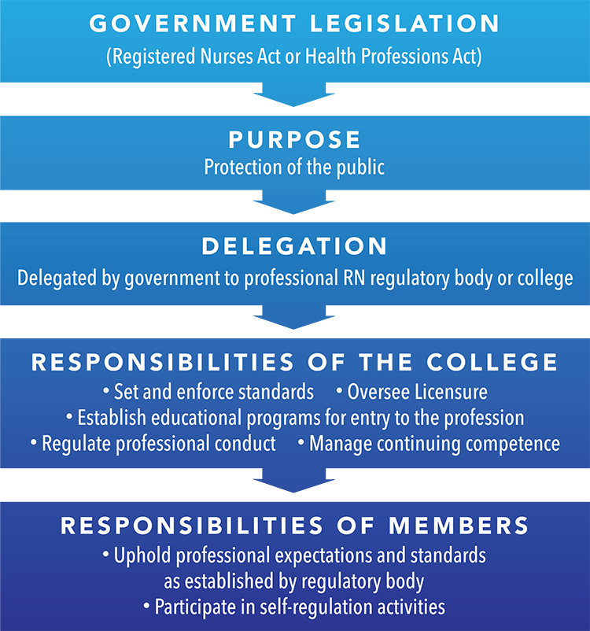
Professional Self-Regulation
Figure 15.2.2 “Professional Self-regulation” by
Beverly Balaski, designed by JVDW Designs is
licensed under a CC BY 4.0 International License.
CC BY 4.0 International License

Slide 15
Unionization of Registered Nurses
Labour unions: organizations that represent workers in their negotiations with employers.
  The primary purpose of a union is to engage in collective bargaining with the employer to determine issues related to wages, terms and conditions of work, and worker security, and to support workers during conflict.
  Collective bargaining: a process whereby members of a profession, supported by their union, meet with representatives of the employer and discuss and negotiate agreements on key issues and concerns
CC BY 4.0 International License

Slide 16
Unionization
Role of unions
  Lobby and work with governments to improve labour and occupational health and safety legislation
  Assist in ensuring standards are upheld
  Unions help to level the playing field by assisting employees through processes negotiated between the workers and the employer
CC BY 4.0 International License

Slide 17
Unions
In-scope:
  Positions that are unionized
Out-of-scope:
  Traditionally positions that are responsible for hiring, firing, and disciplining workers are classified as out-of-scope
  Are not unionized
CC BY 4.0 International License

Slide 18
Collective Bargaining Agreement
The collective bargaining agreement (CBA) essentially contains the “rules” that direct the workplace.
Concerns around workload, staffing, and the inability to uphold professional standards as developed by the professional regulatory body were not directly identified in the CBA.
CC BY 4.0 International License

Slide 19
Benefits of Unions
Nursing unions have significant impact on members, patients, and society as a whole.
Research has shown that the higher the number of unionized employees in a workplace, the better the overall health of workers and the lower the poverty rates, for both union and non-unionized workers (Mishel, 2012; Raphael, 2006).
Nursing unions ensure safe practice environments; this translates into better care for patients (Twarog, 2005).
CC BY 4.0 International License

Slide 20
Essential Learning Activity 15.3.1
For more information, see the comparison chart of union and non-union benefits hosted on the Massachusetts Nurses Association’s webpage under “Union Rights and Benefits,” then answer the following question:
  Would you prefer to work in an organization where the nurses are unionized or non-unionized? Explain your answer.
CC BY 4.0 International License

Slide 21
Similarities and Differences Between Professional Self-regulation and Unionization
For the regulatory body, protection of the public is not possible if their members are faced with unsafe and unsupportive work environments that do not use research and best practice guidelines as the foundation of care provided.
For the union, CBAs alone cannot resolve issues of professional practice. Unions also vigorously promote the use of best practice research as this not only establishes quality workplaces for members, but also ensures a safe environment in which patients are provided care.
CC BY 4.0 International License

Slide 22
Essential Learning Activity 15.4.1
For more information follow the link to the comparison chart of the “Three Pillars of Registered Nursing” supports: Regulatory Body, Professional Association and Union, published by the College of Registered Nurses of Manitoba. Nurse Link, Winter 2017, (p. 10).
Answer the following questions:
  Describe the difference in mandates for each group.
  Which group would you approach for information on nursing standards?
CC BY 4.0 International License

Slide 23
Other Organizations
Canadian Nurses Association: the national professional voice for registered nurses.
  Achieves positive health outcomes in the public interest
  Promotes profession-led regulation in the public interest
  Acts in the public interest for Canadian RNs, providing national and international leadership in nursing and health
  Advocates in the public interest for a publicly funded, not-for-profit health system
CC BY 4.0 International License

Slide 24
Other Organizations (Cont’d)
Canadian Federation of Nurses Unions: another organization representing nurses, has the mandate to protect nurses and speak on behalf of the profession.
  Advances patient care
  Improves working conditions
  Advocates for strong publicly funded health care systems
  Engages in the development, utilization, and dissemination of evidence to inform policy decisions
CC BY 4.0 International License

Slide 25
Other Organizations (Cont’d)
Canadian Nurses Protective Society:
  Offers legal advice
  Risk management services
  Legal assistance
  Liability protection
CC BY 4.0 International License

Slide 26
Other Organizations (Cont’d)
Canadian Indigenous Nurses Association: non-profit organization dedicated to improving the health of Indigenous people in Canada.
  Engagement, recruitment, and retention of Indigenous nurses
CC BY 4.0 International License

Slide 27
Essential Learning Activity 15.5.1
Read more about the CNA on the About Us and Member Benefits sections of its website, then answer the following questions:
  What are the CNA’s objectives and goals?
  What are the benefits of being a CNA member?
CC BY 4.0 International License

Slide 28
Essential Learning Activity 15.5.2
Read more about the CFNU’s advocacy on its website, then answer the following question:
  What are the political action initiatives of CFNU?
CC BY 4.0 International License

Slide 29
Essential Learning Activity 15.5.3
Learn more about the CNPS’s mandate, services, and publications. For more information, see the CNPS infoLAWS bulletins.
CC BY 4.0 International License

Slide 30
Essential Learning Activity 15.5.4
Read about the formation of the CINA, then answer the following question:
  What were the visionary goals of Jocelyn Bruyere and Jean Goodwill, two of the organization’s founders?
Read more about CINA projects, then complete the following exercise:
  Describe some specific CINA projects.
CC BY 4.0 International License

Slide 31
Exercises for Review
Union-focused questions
Regulatory-focused questions
Please refer to the textbook and review the exercise questions for Chapter 15.
CC BY 4.0 International License

Slide 32
References
Canadian Nurses Association. (2007). Understanding self-regulation. Nursing Now: Issues and Trends in Canadian Nursing, 21, 1–5.
Duncan, S., Thorne, S., & Rodney, P. (2012). Understanding the implications of the changing regulatory environment in nursing: Insights from the B.C. experience. Vancouver: Association of Registered Nurses of British Columbia.
Mishel, L. (2012). Unions, inequality, and faltering middle-class wages. Economic Policy Institute Issue Brief, 342, 1–12. Retrieved from http://www.epi.org/files/2012/ib342-unions-inequality-middle-class-wages.pdf
Twarog, J. (2005 May). The benefits of union membership: Numerous and measurable. Massachusetts Nurses Association Newsletter. Retrieved from http://www.massnurses.org/labor-action/labor-education-resources/union-rights-and-benefits/p/openItem/1214
CC BY 4.0 International License

Slide 33

Presenters
Presented by
Thank you!
Creative commons attribution 4.0 International license
June 2018

